Slide 1
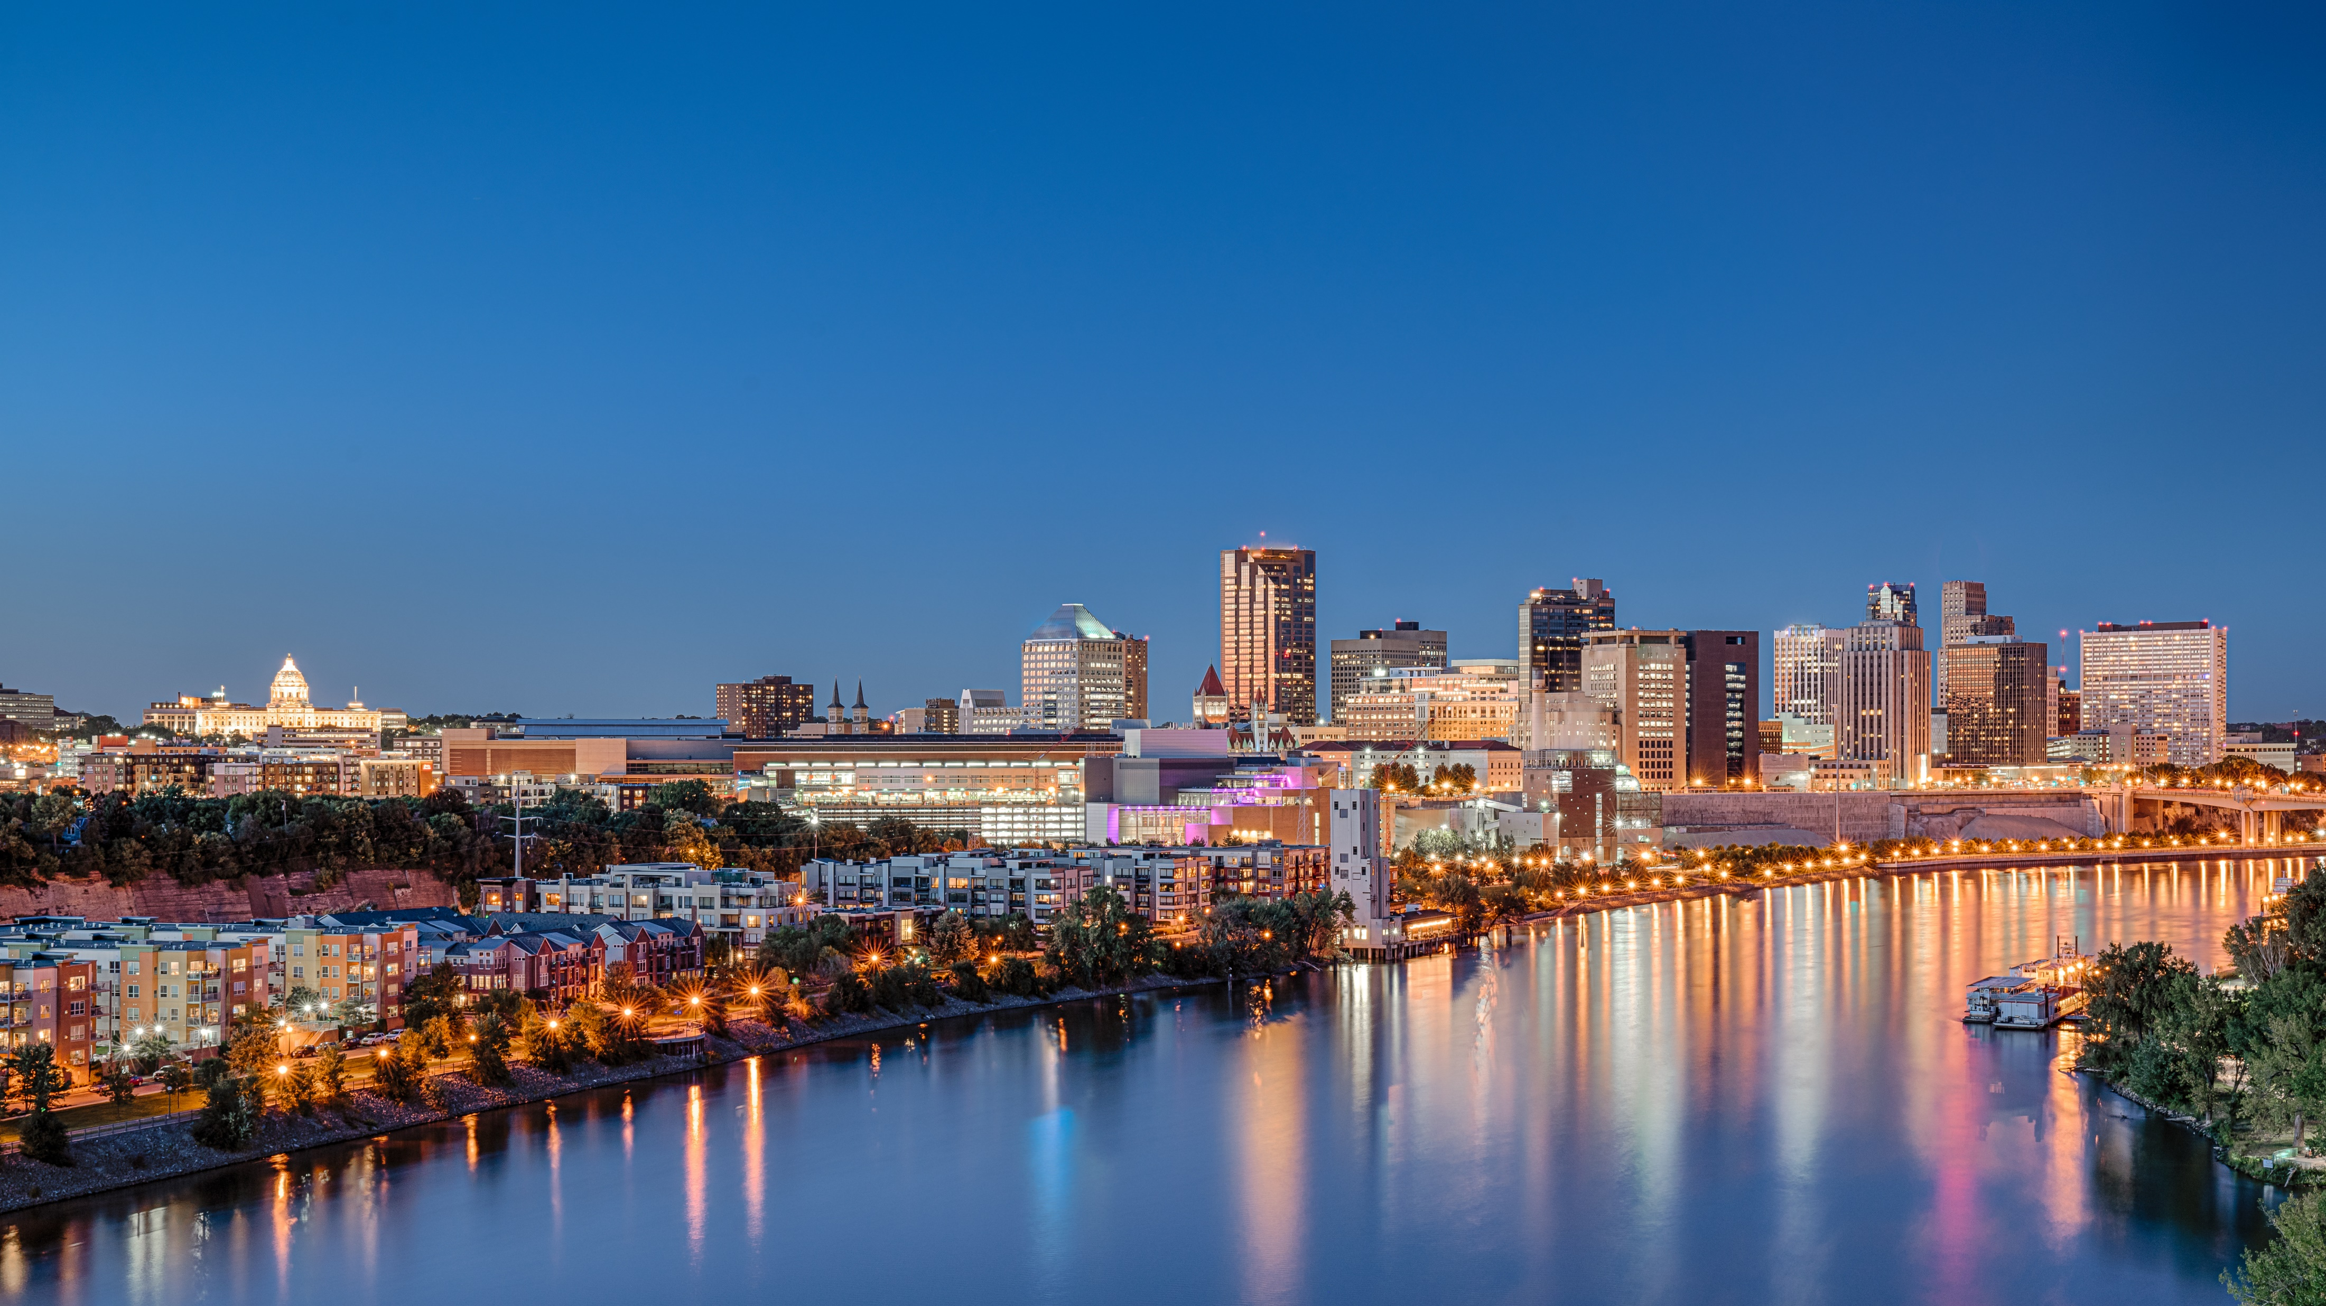

Investor Update
January 25, 2024
ws.partners
Notes:
JH

Slide 2
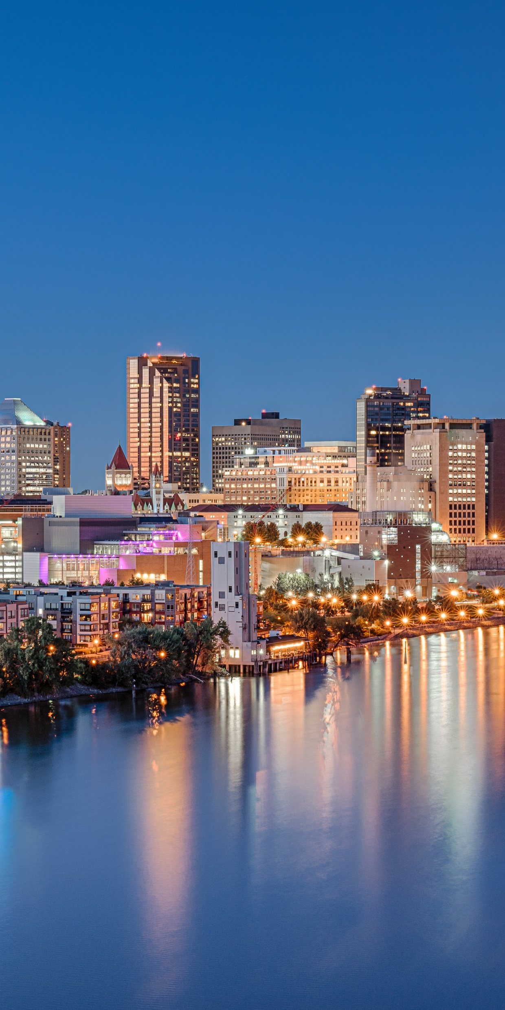
Agenda
- Welcome
- What are we seeing?
- Fund I Updates
- Fund II Updates
- Fund III Overview
- Questions
5 min.
5 min.
20 min.
20 min.
10 min.
ws.partners
Notes:
JH

Slide 3
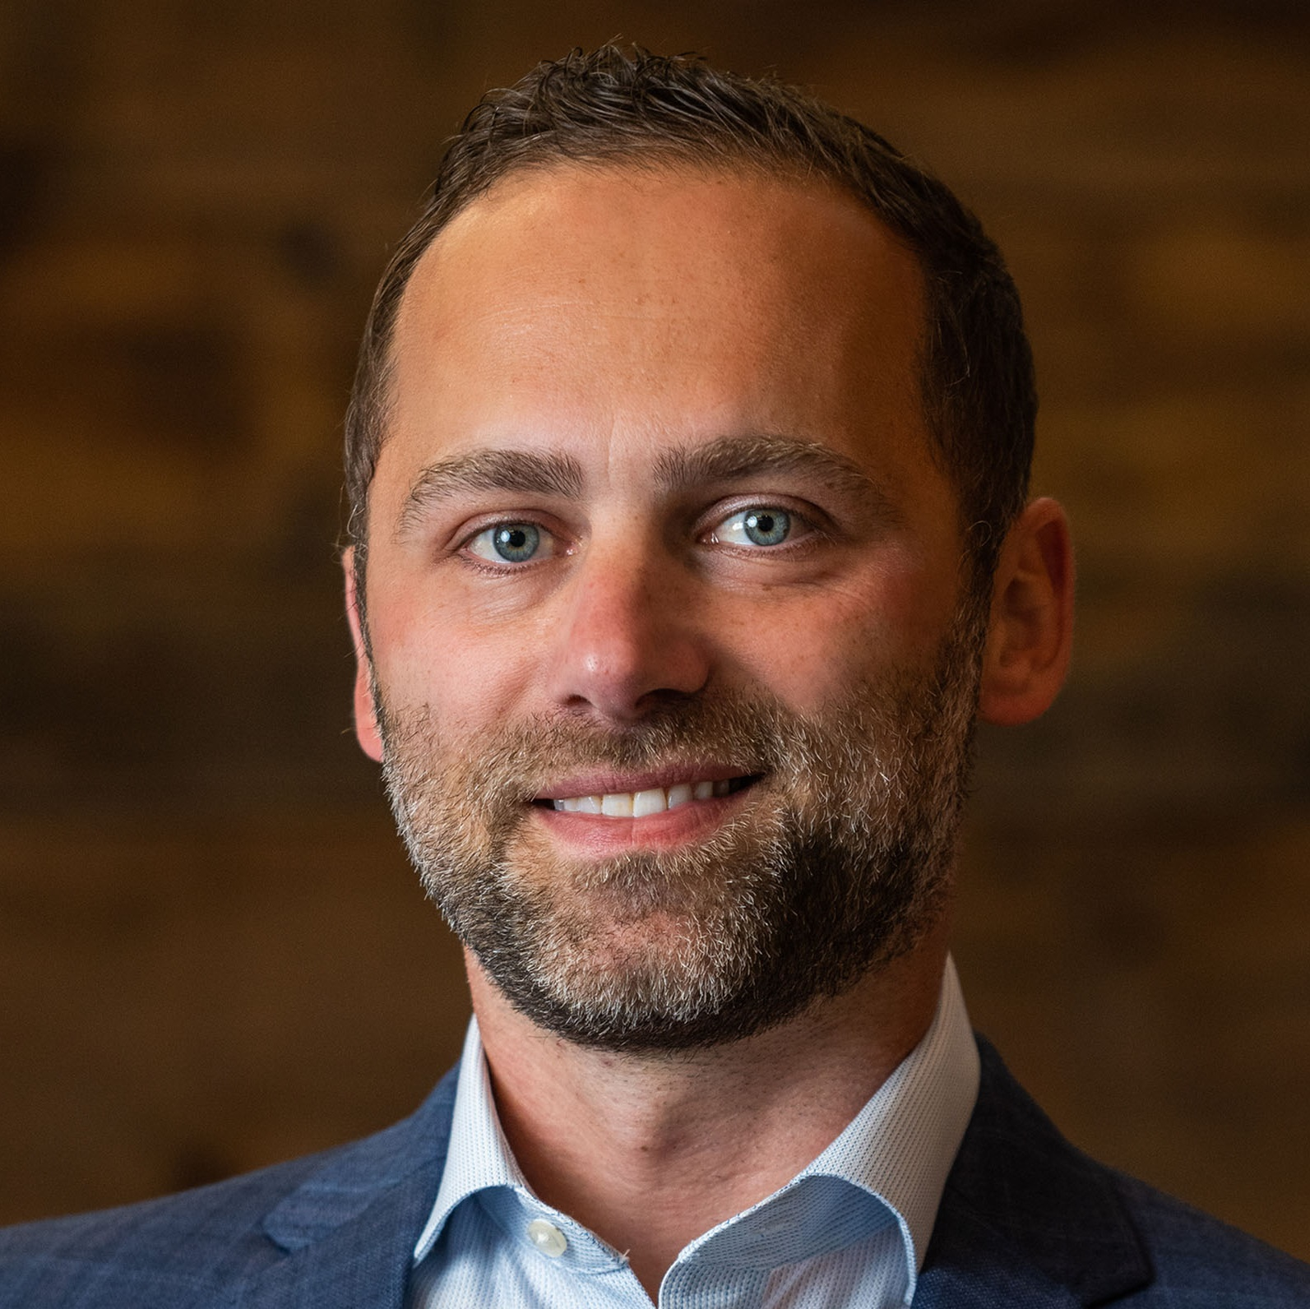
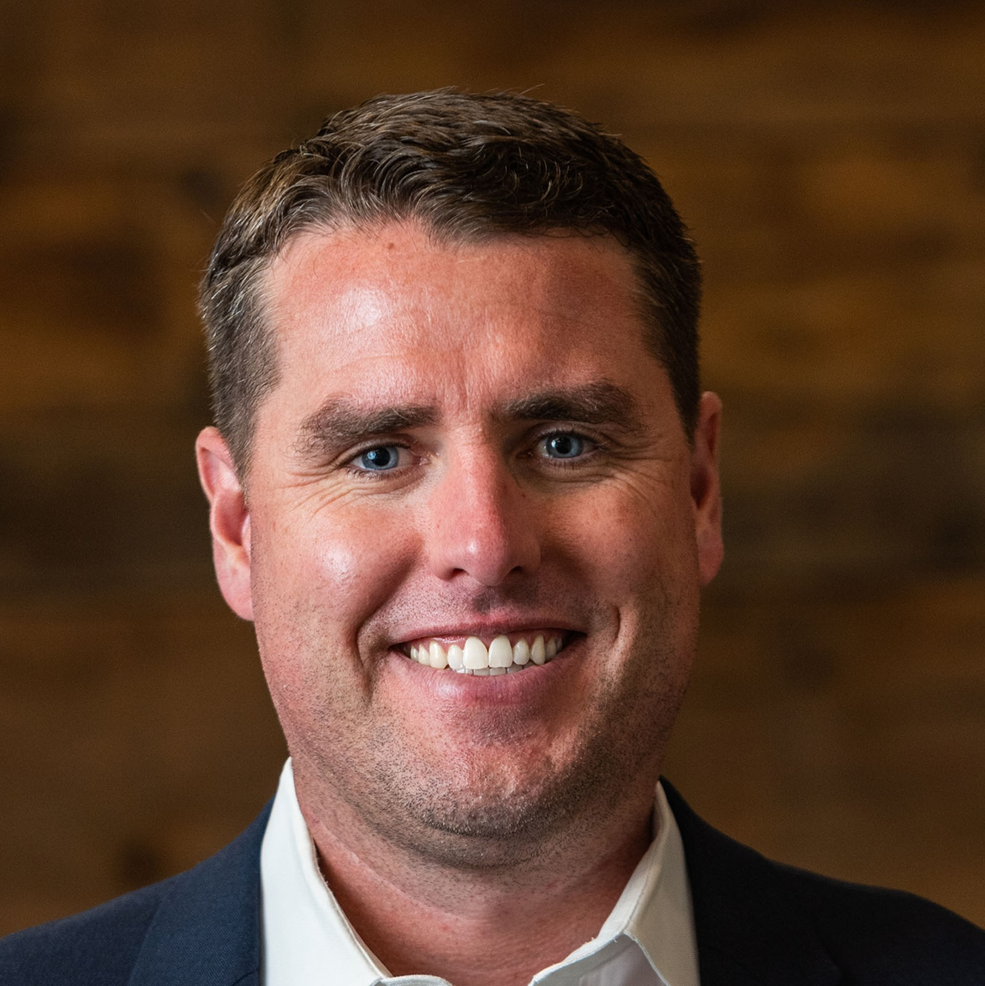
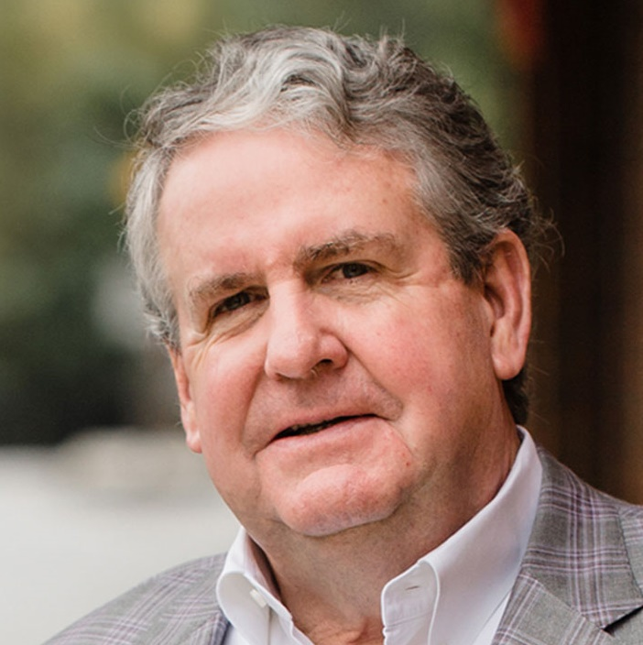
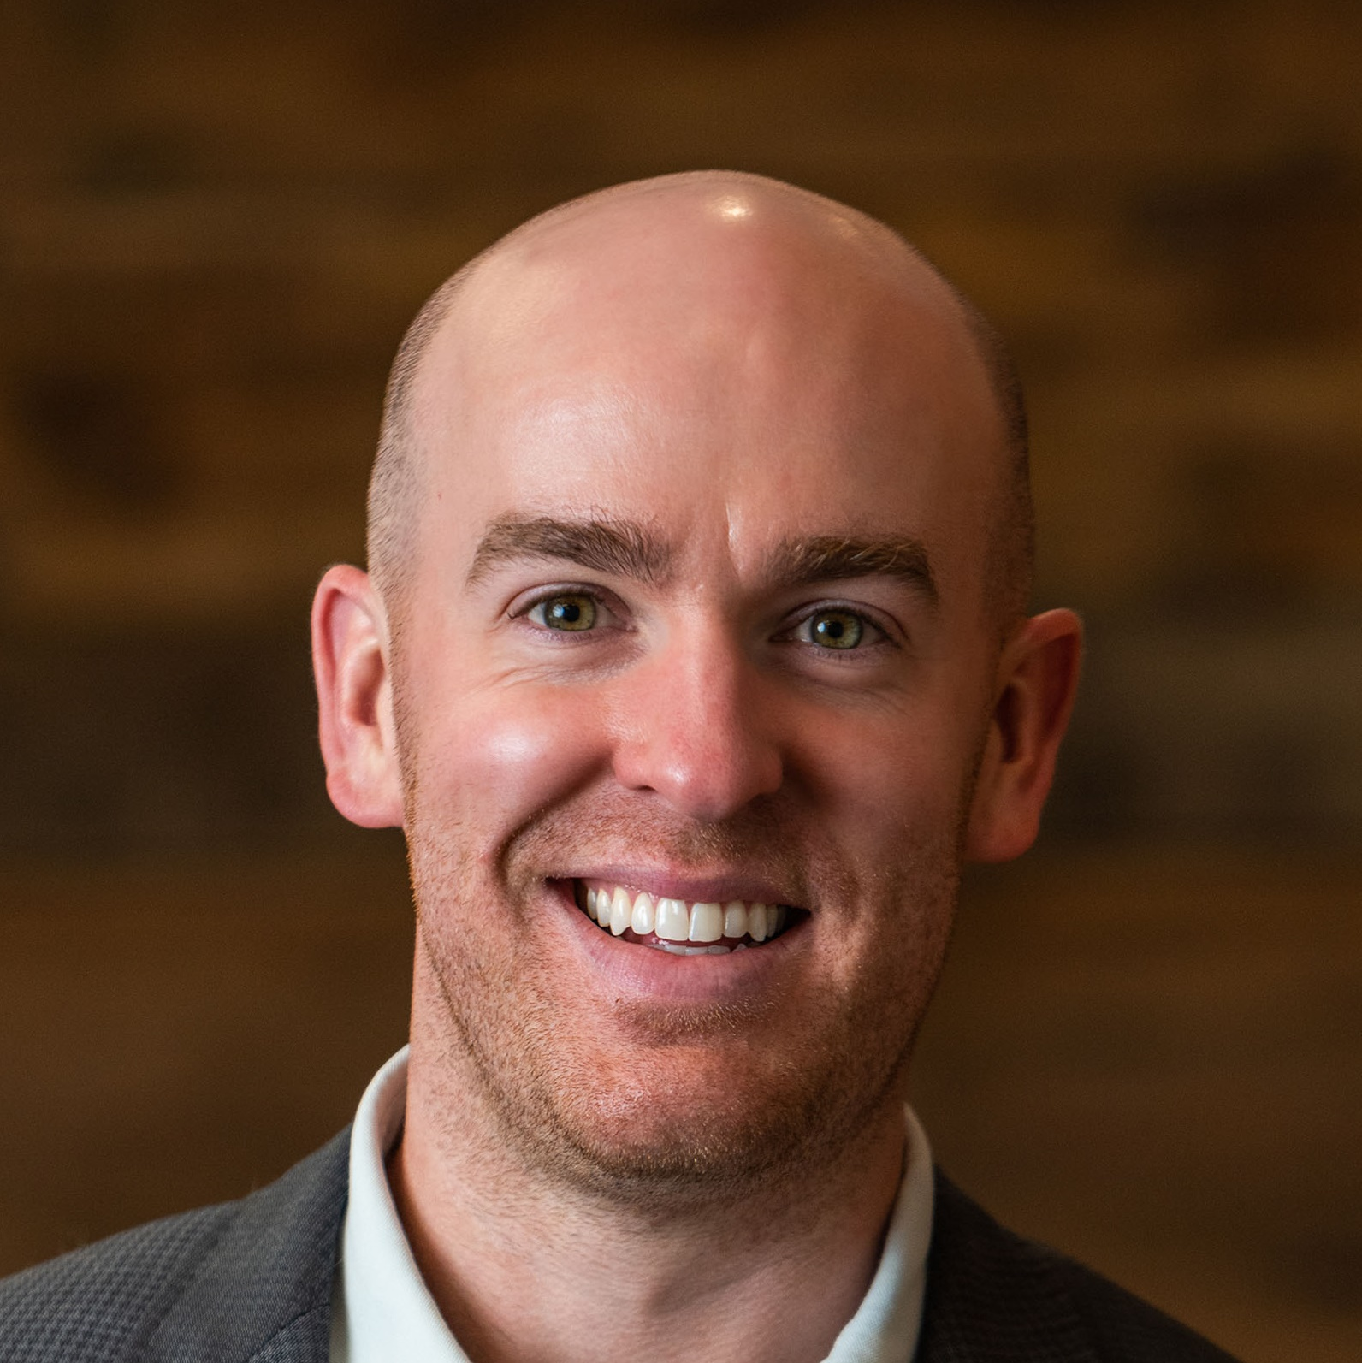
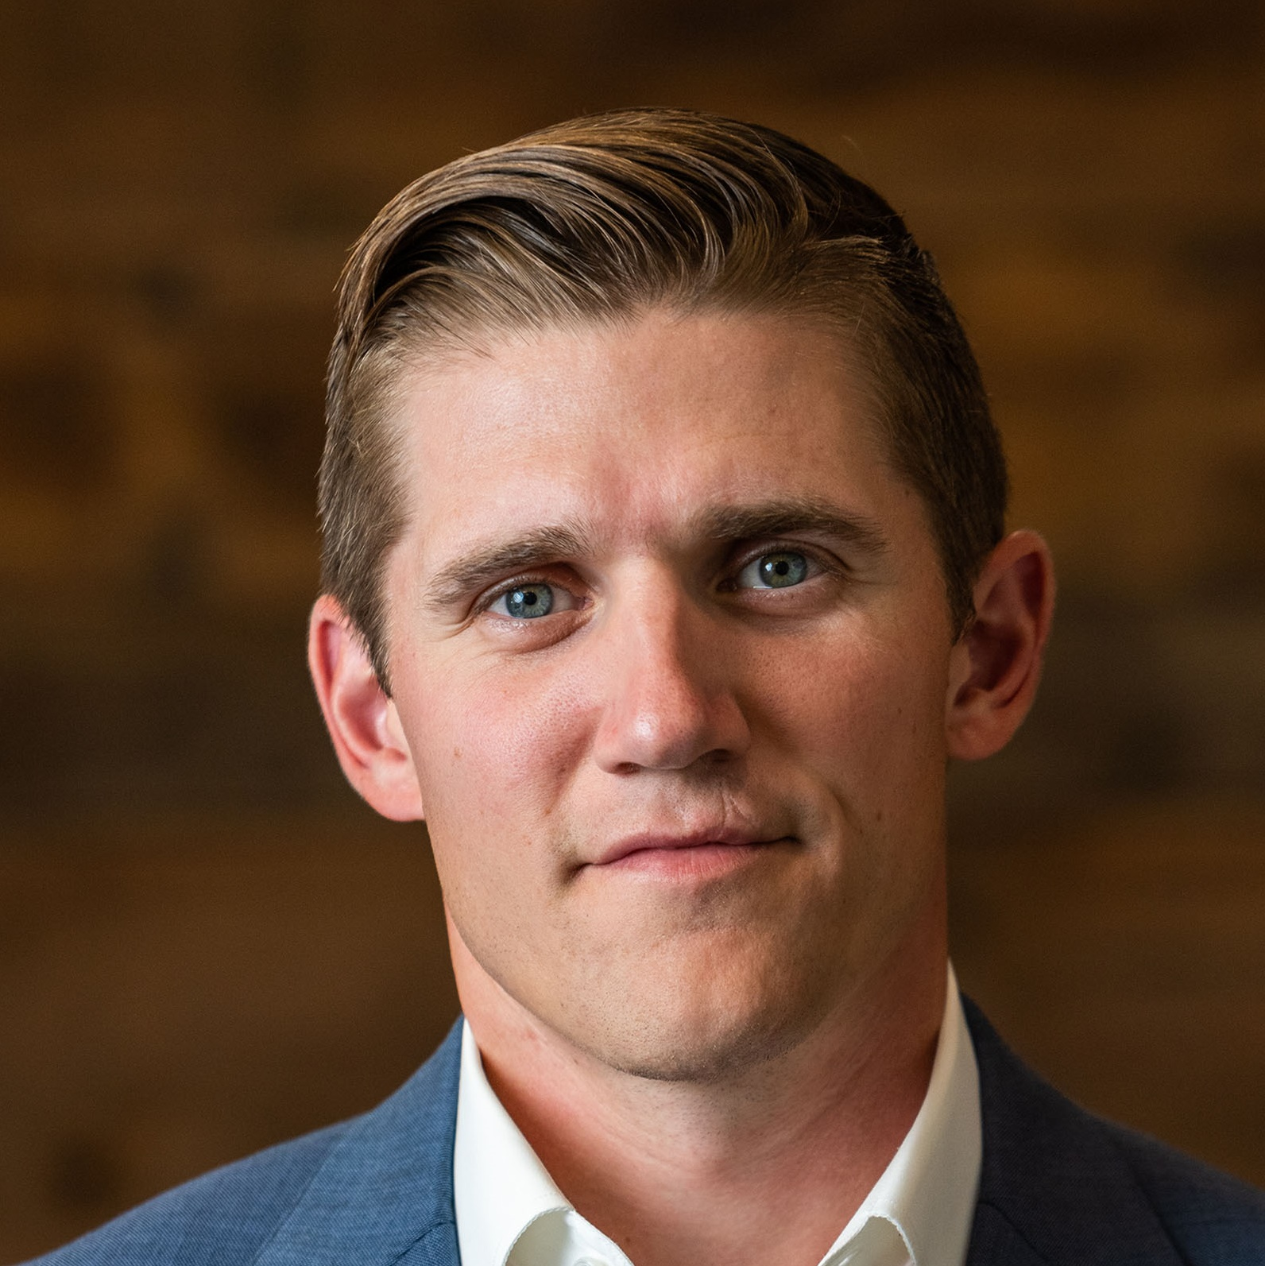
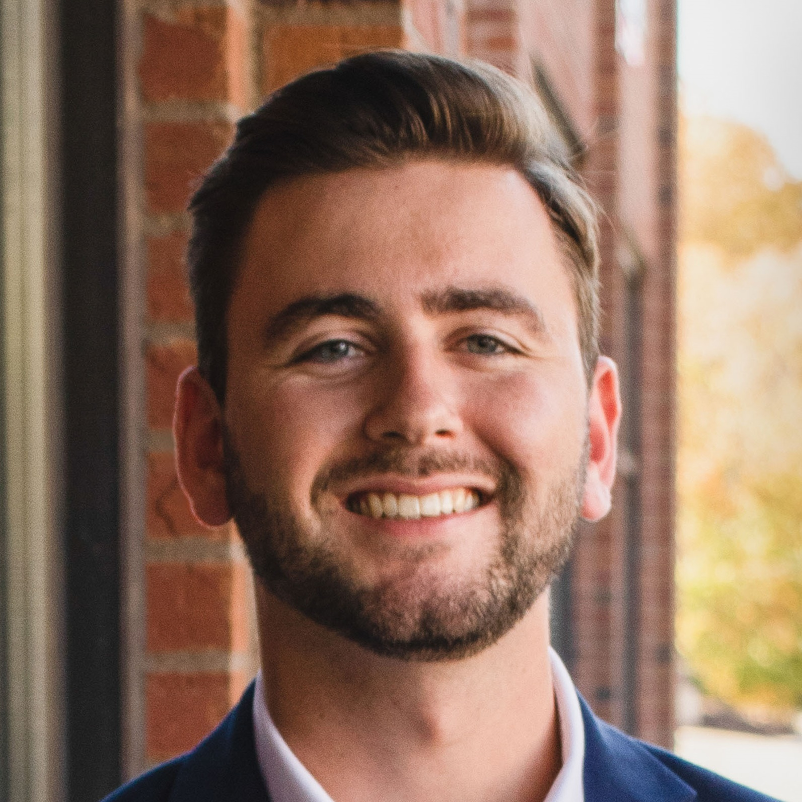
It’s nice to see you!
Jim Hegedus
Joe Boone
Joe Ryan
ws.partners
Jack Ryan
Matt Carle
Ryan Durand
Notes:
JH

Slide 4























It takes a village…
IMI
ws.partners
Notes:
JH

Slide 5
What are we seeing?
2023 was another strange year…
- The Fed increased rates another 100 bps
- Inflation continued its slow descent
- Bank failures early in the year
In real estate, we saw…
- Challenges obtaining debt for investments
- Real estate transaction volume plummeted
- Cap rates increased across property types
ws.partners
Notes:
JB
Fed Funds rate increased 100 bps in 2023; on top of 425 bps in 2022!

Slide 6
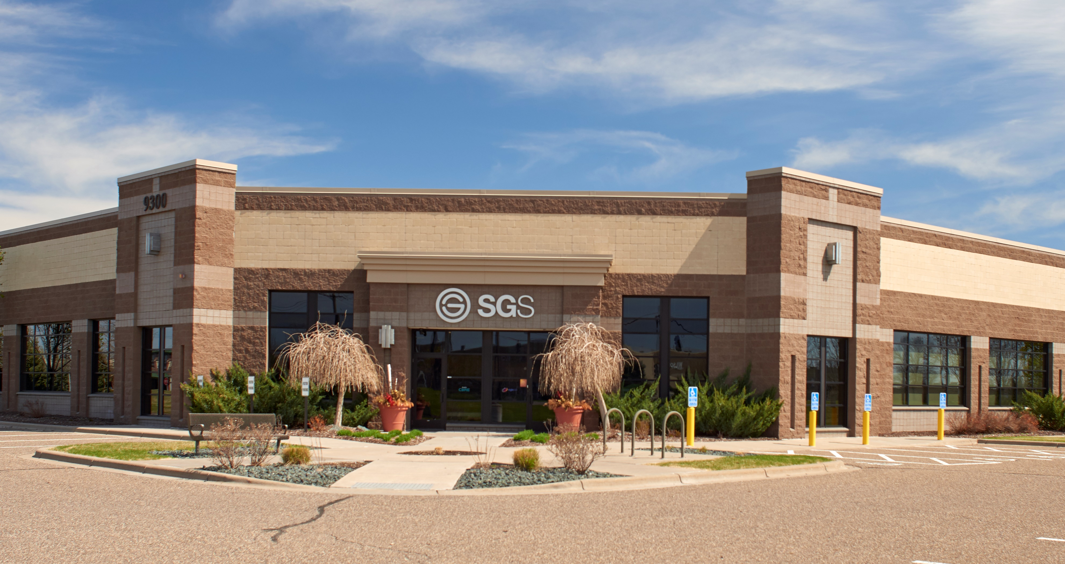
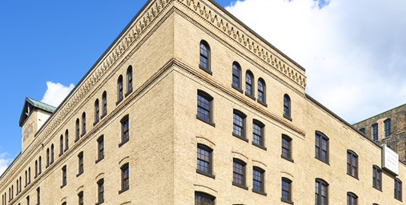
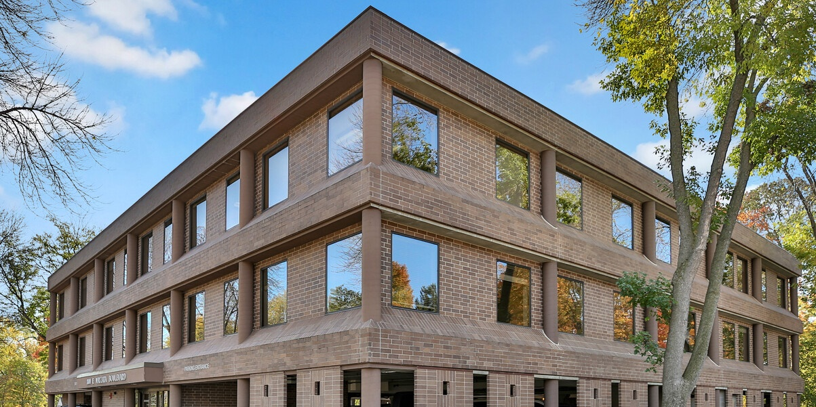
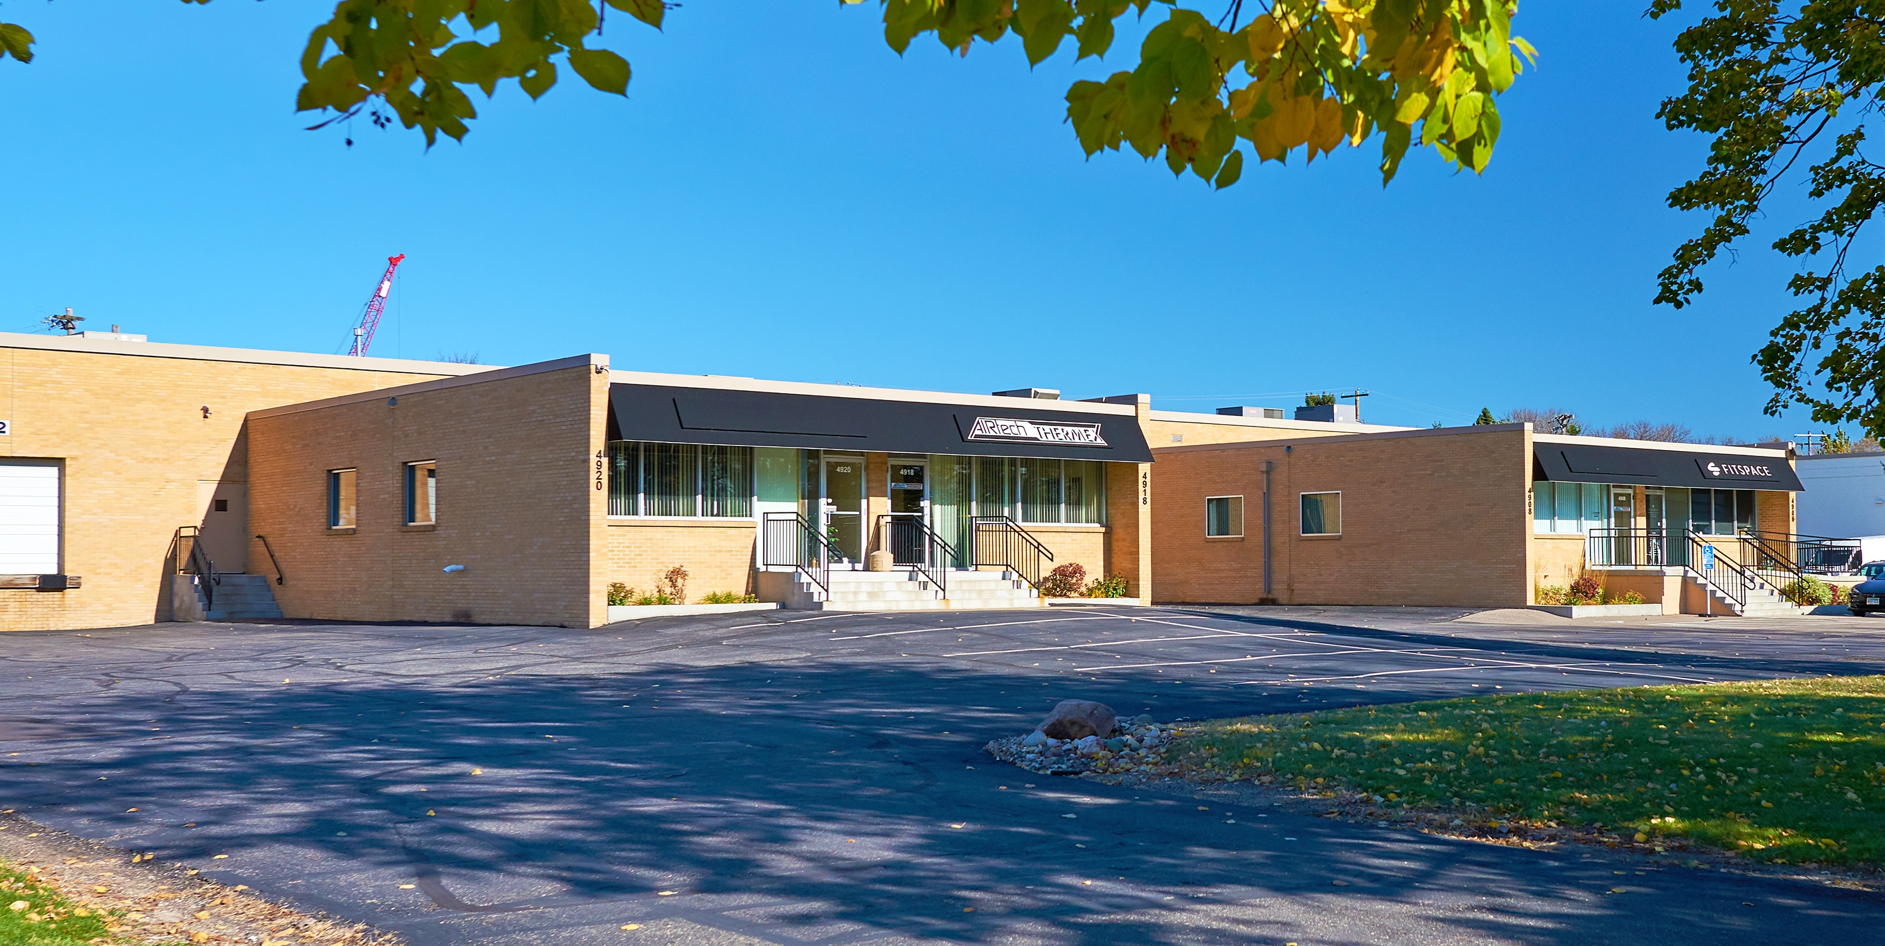
Big wins despite challenges
- Whitewater stabilized!
- Beltline back to 100% leased!
- Extended Amazon parking lease!
- Winnebago lease commenced!
- Property taxes reduced at Beltline!
- Fund II investment into data centers!
ws.partners
Notes:
JB

Slide 7
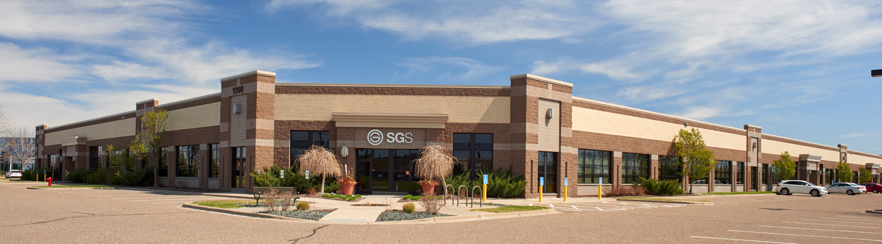
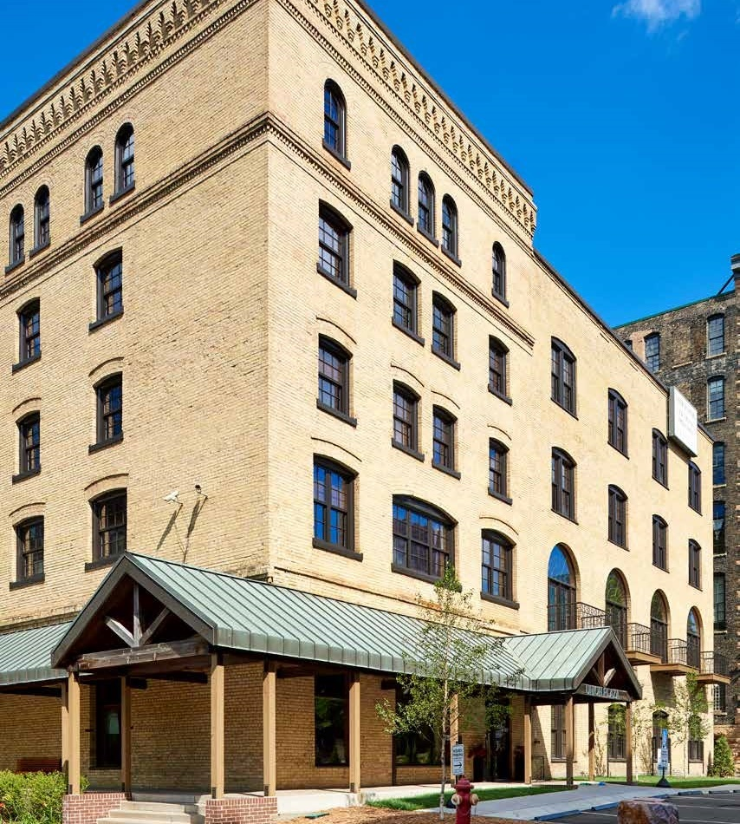
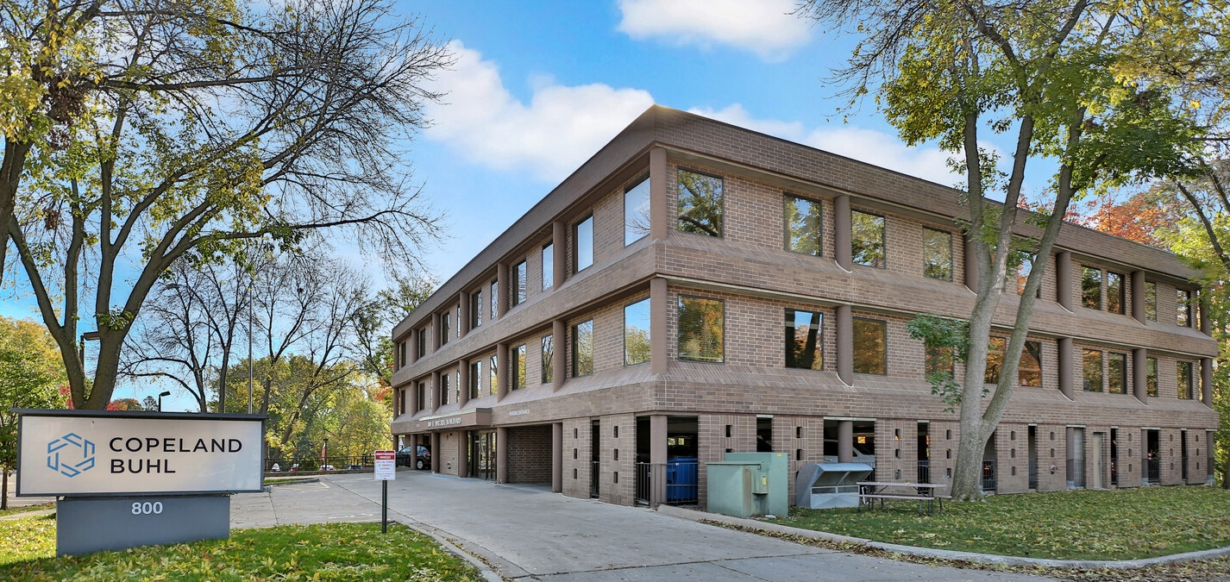
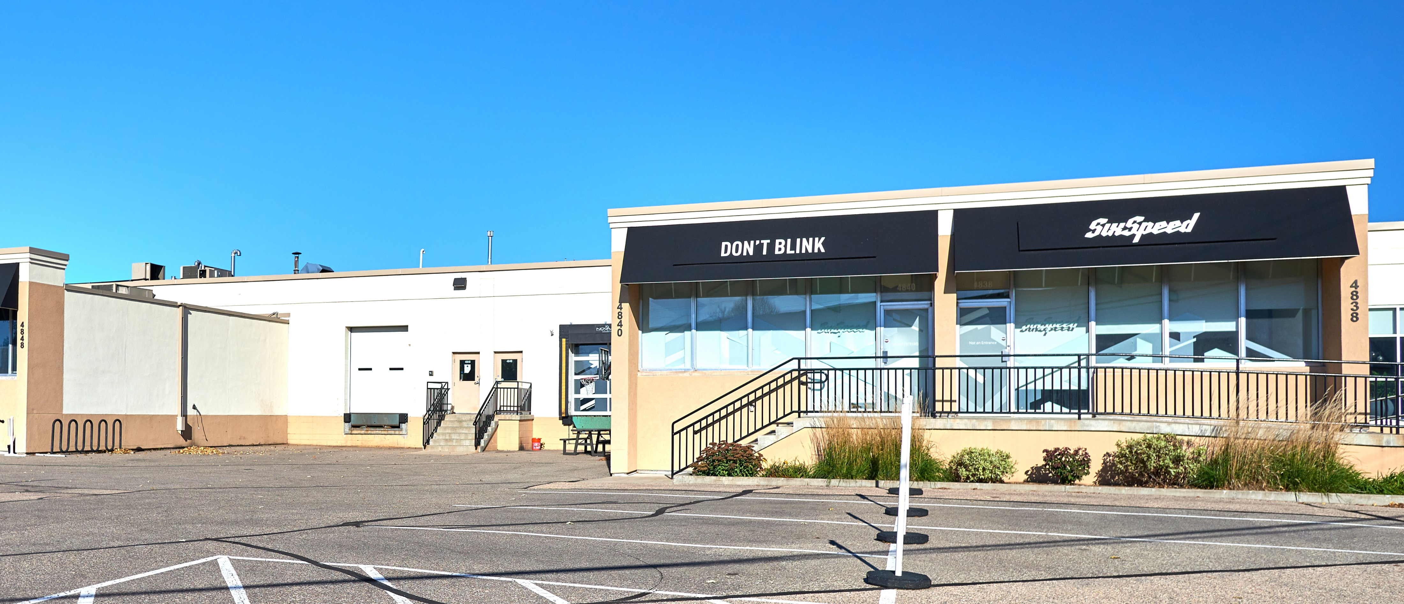
WATER STREET FUND I
ws.partners
Notes:
JR

Slide 8
The big picture…
Initial Closing:
Final Investment:
Capital Calls:
Distributions:
Avg. Cash Flow:
Leverage:
Leased:
Targeted IRR (Net):
Sept. 2018
Sept. 2020
$10.00MM
$2.57MM
7.10%
60.0%
93.4%
9% - 11%
FUND I
ws.partners
Notes:
JR

Slide 9
Strong NOI growth…
Current
NOI %
9.97%
5.48%
10.20%
8.47%
Initial
NOI %
9.05%
4.47%
9.58%
7.06%
Change
+0.92%
+1.01%
+0.62%
+1.41%
610
Union¹
Wayzata
Beltline
FUND I
ws.partners
¹ Current projected stabilized yield for Union Plaza is 10.42%
Notes:
JR

Slide 10
Loan Maturities
Rate
6.32%
6.52%
4.05%
3.39%
5.40%
LTC
58.6%
64.8%
59.0%
59.0%
60.0%
Maturity
Oct-27
Oct-27
Jan-25
Sep-25
610
Union
Wayzata
Beltline
Average
FUND I
ws.partners
Notes:
JR

Slide 11
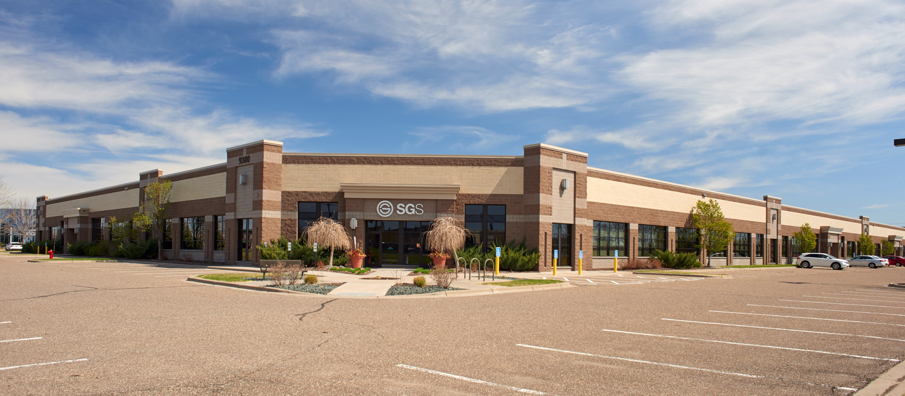
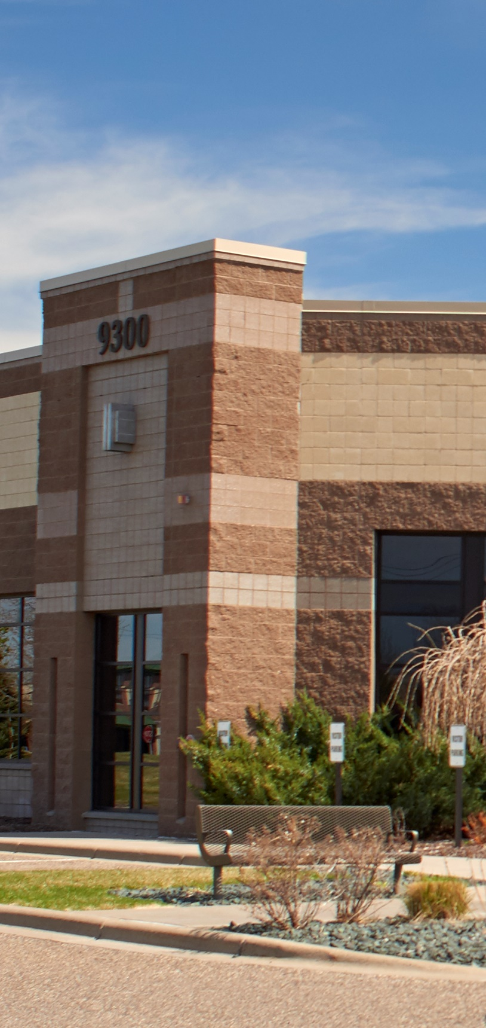
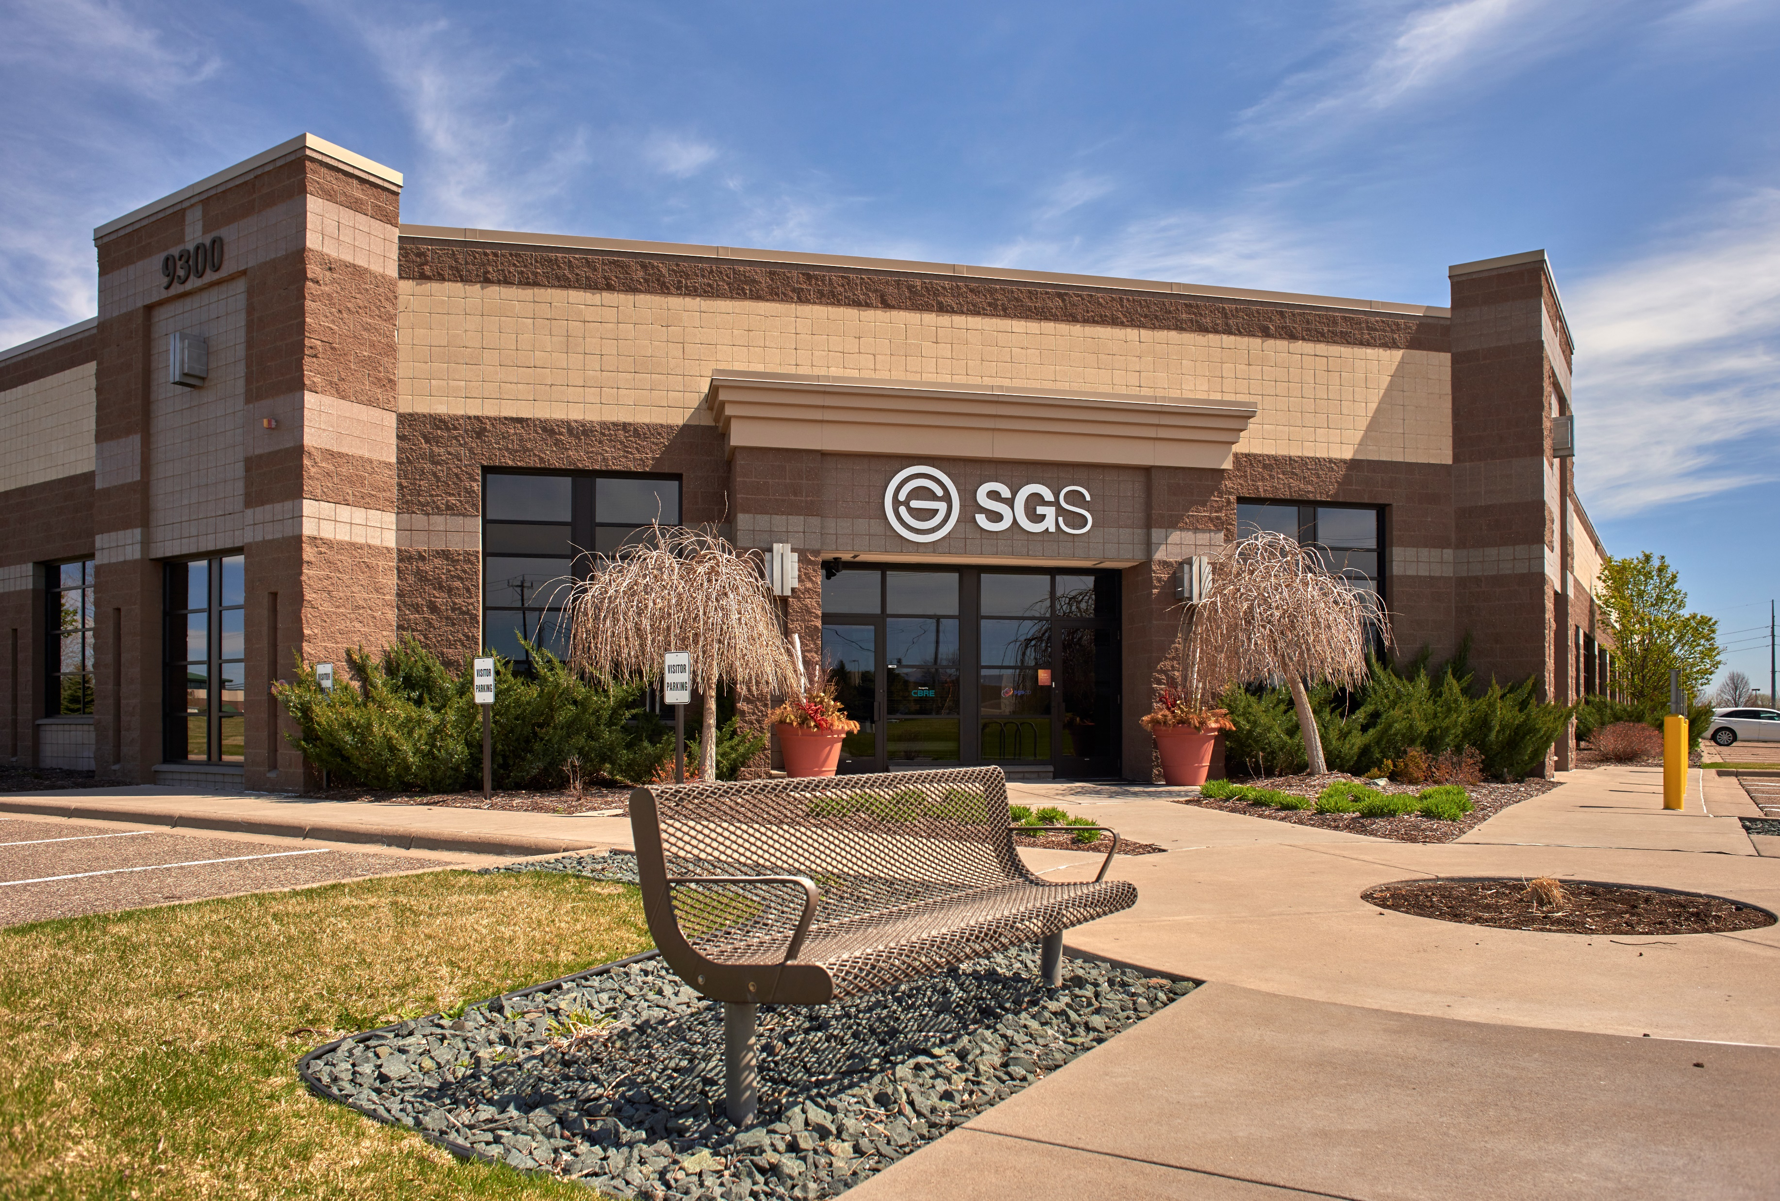
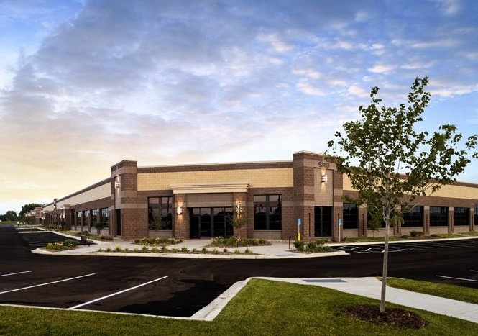
610 BUSINESS CENTER
ws.partners
Notes:
JR

Slide 12
Results to Date
- Navigated pandemic and ownership change
- Built rapport with leadership and employees
- Maintained property in first class manner
2024 & Beyond
- Secure new tenant for ~30,000 square feet
- Execute long-term renewal SGS
610 BUSINESS CENTER
ws.partners
Notes:
JR

Slide 13
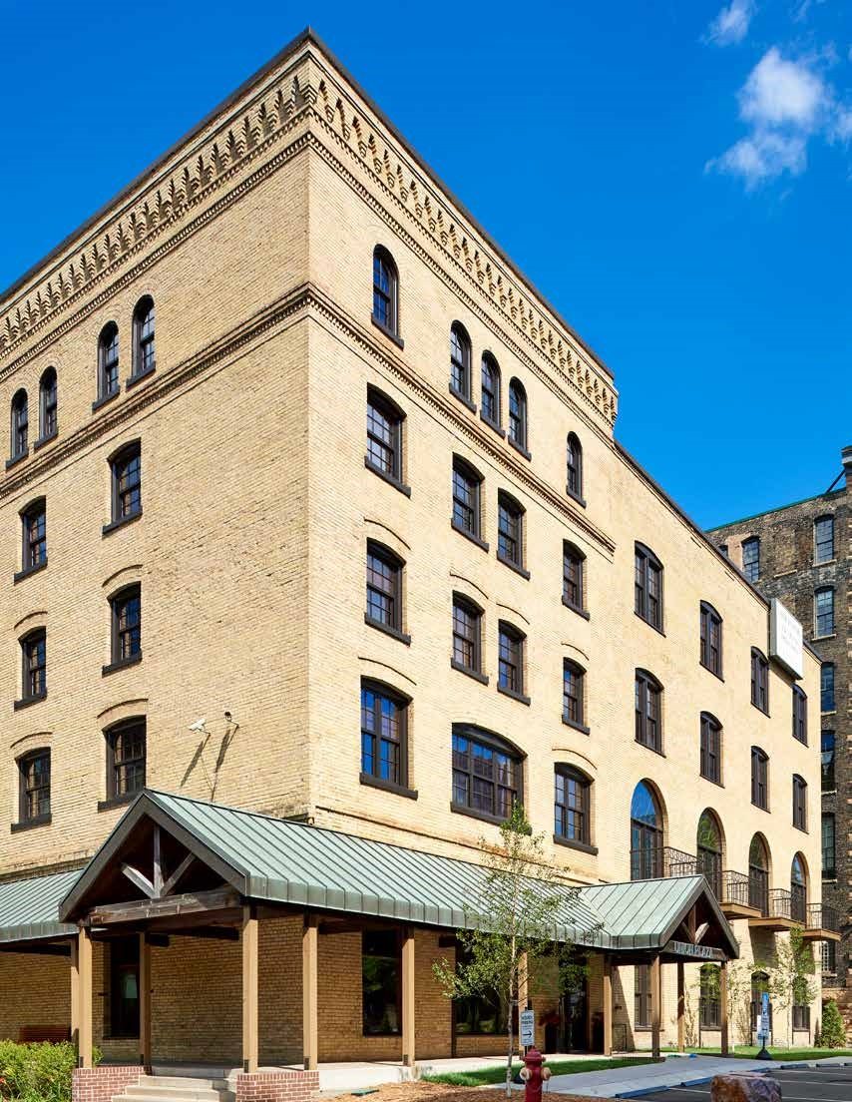
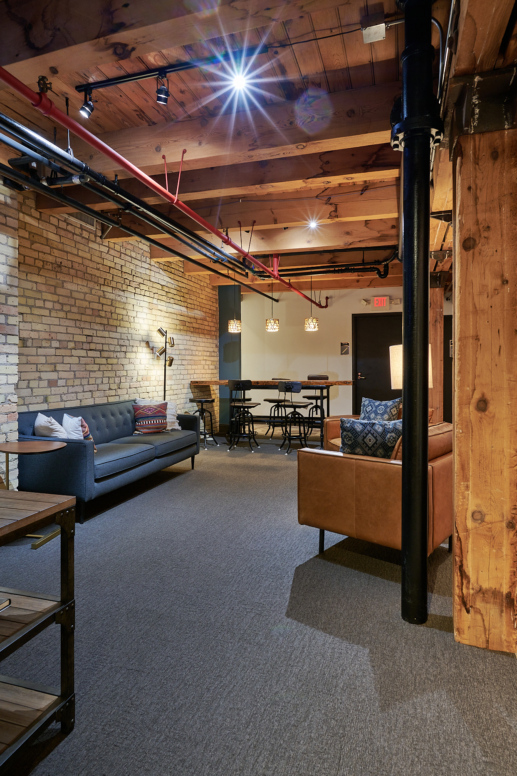
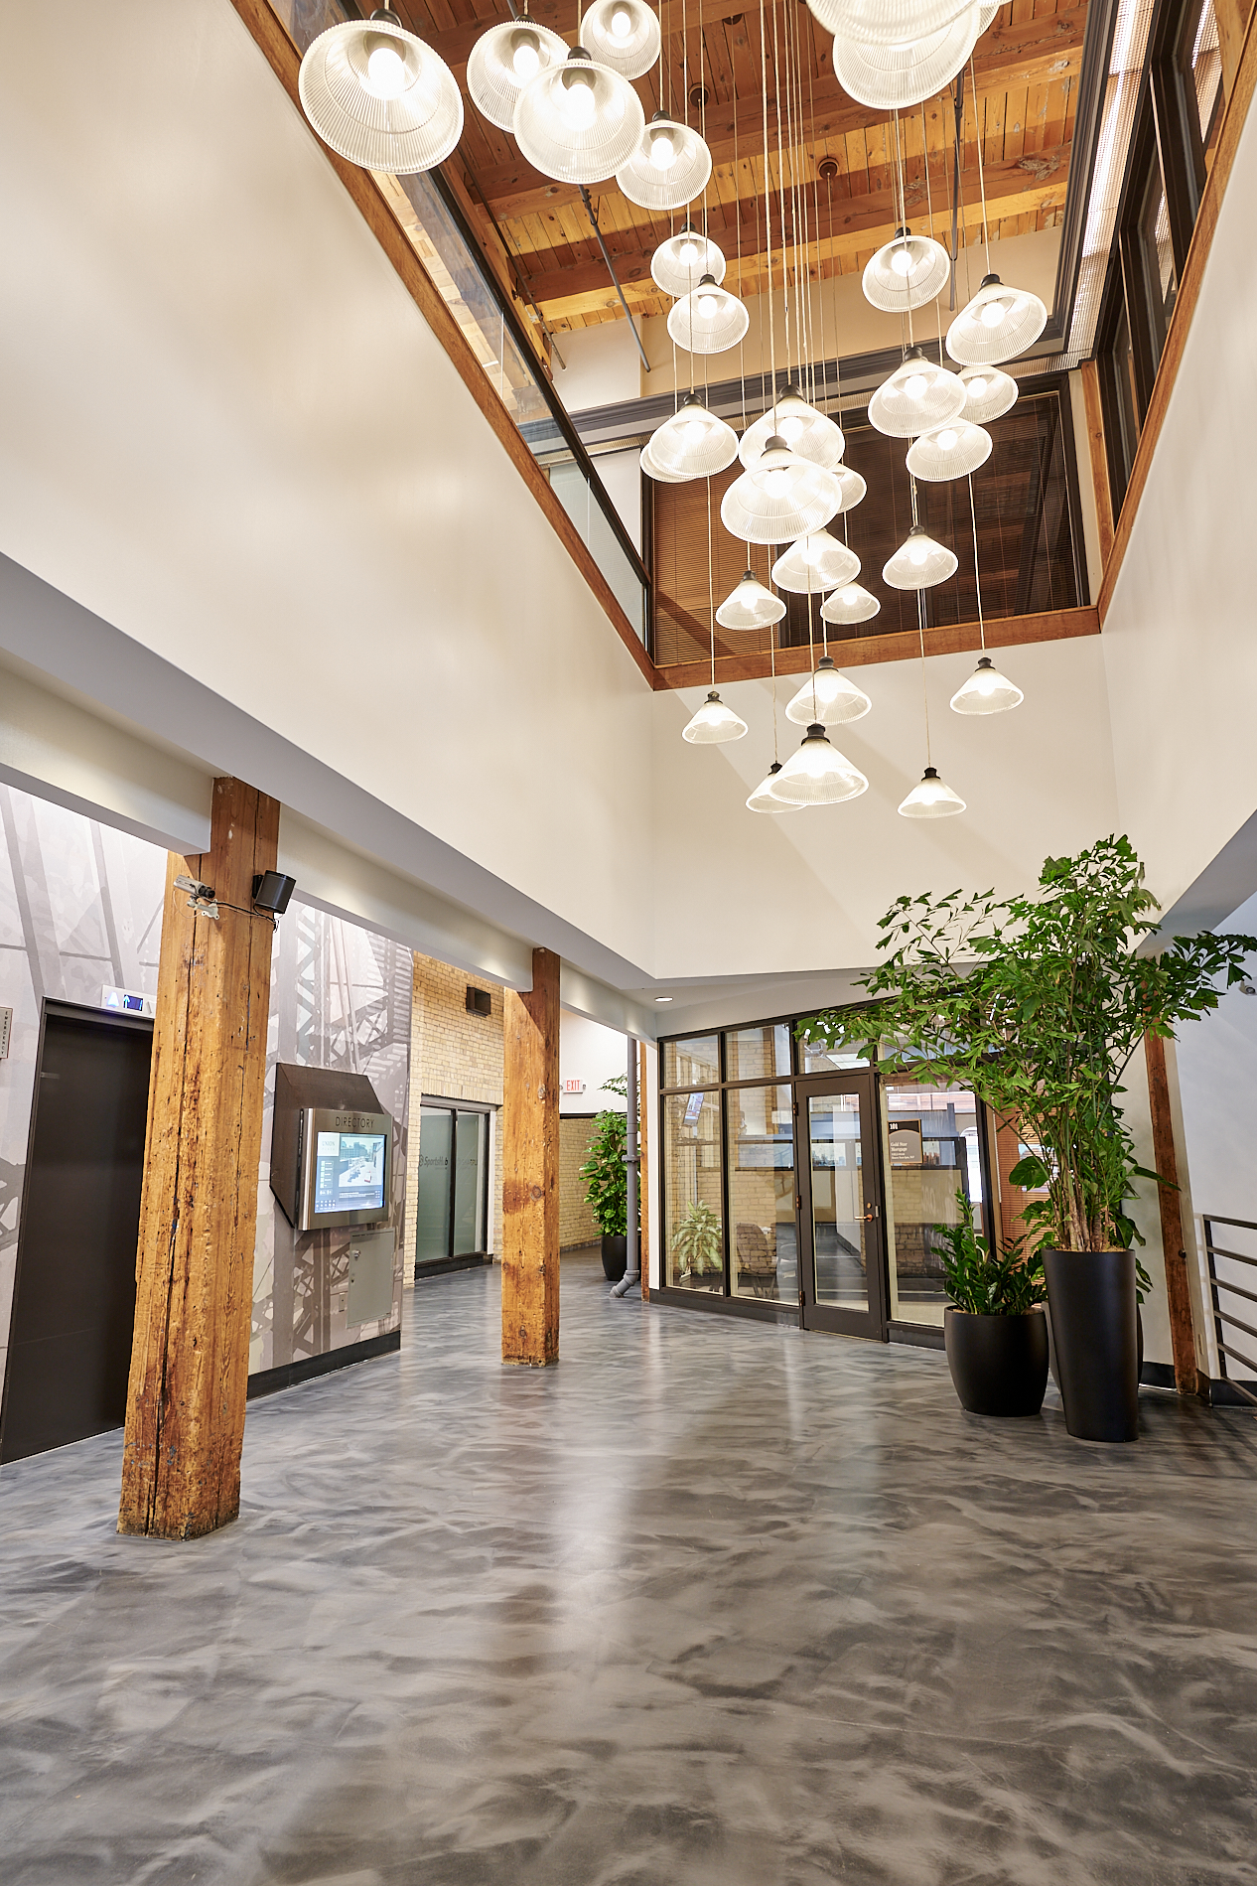
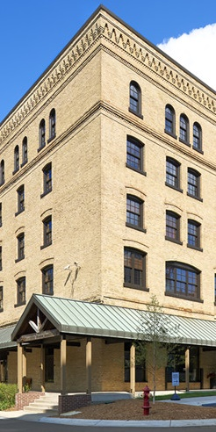
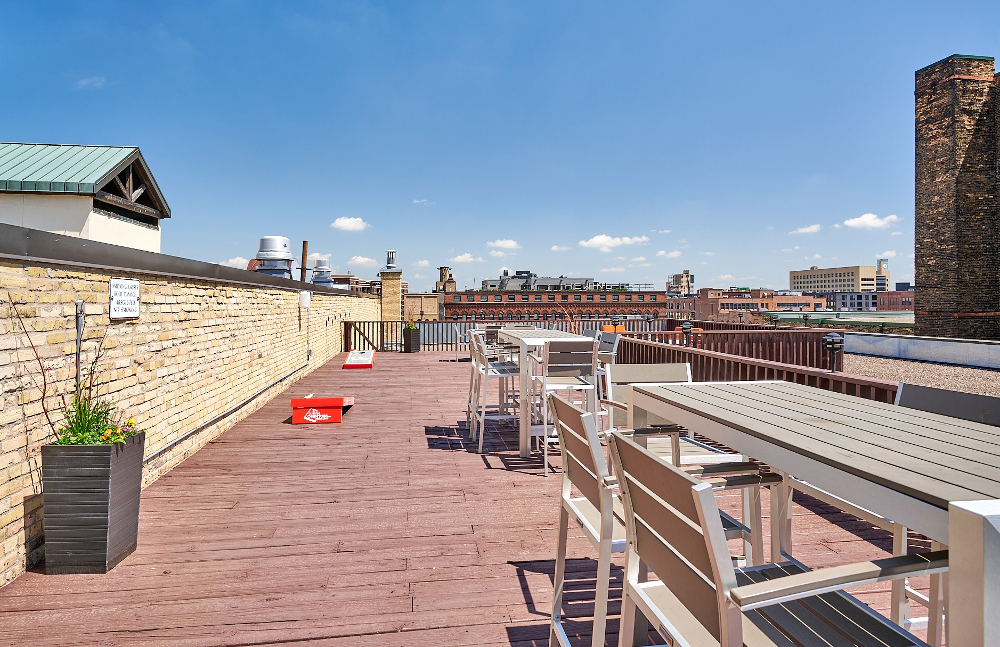
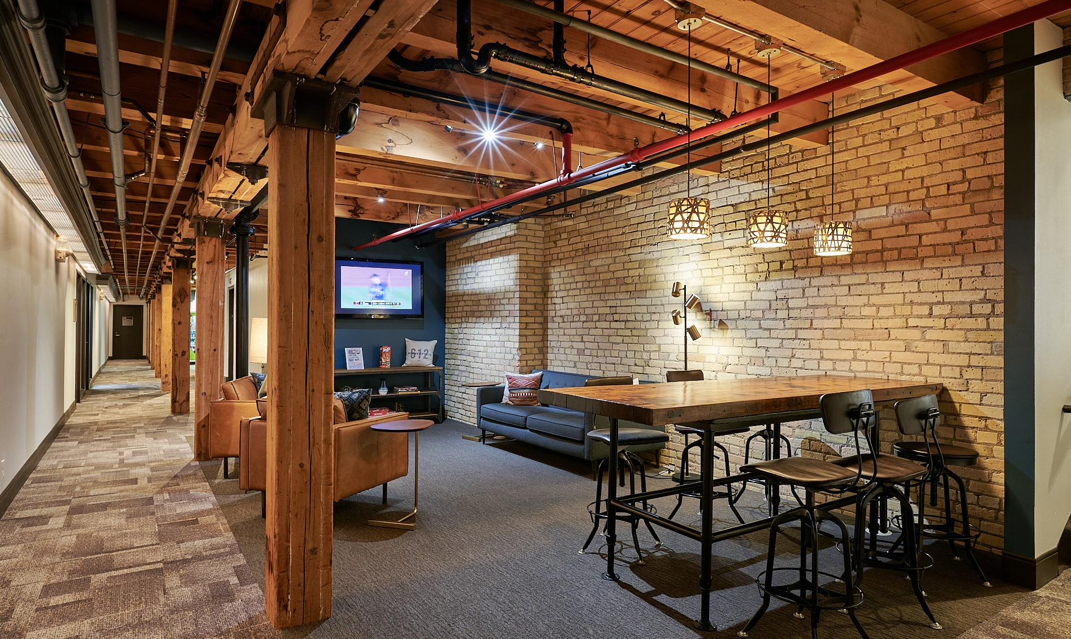
UNION
PLAZA
ws.partners
Notes:
JR

Slide 14
Results to Date
- Completed lobby, amenity and mech. projects
- Increased occupancy by 8.2% (to 76.1%)
- Increased in-place rents by $3.62 (32%!)
2024 & Beyond
- Achieve 90% occupancy (+9,286 sf)
- Continue to increase rents
- Execute long-term solution for third floor
UNION
PLAZA
ws.partners
Notes:
JR

Slide 15
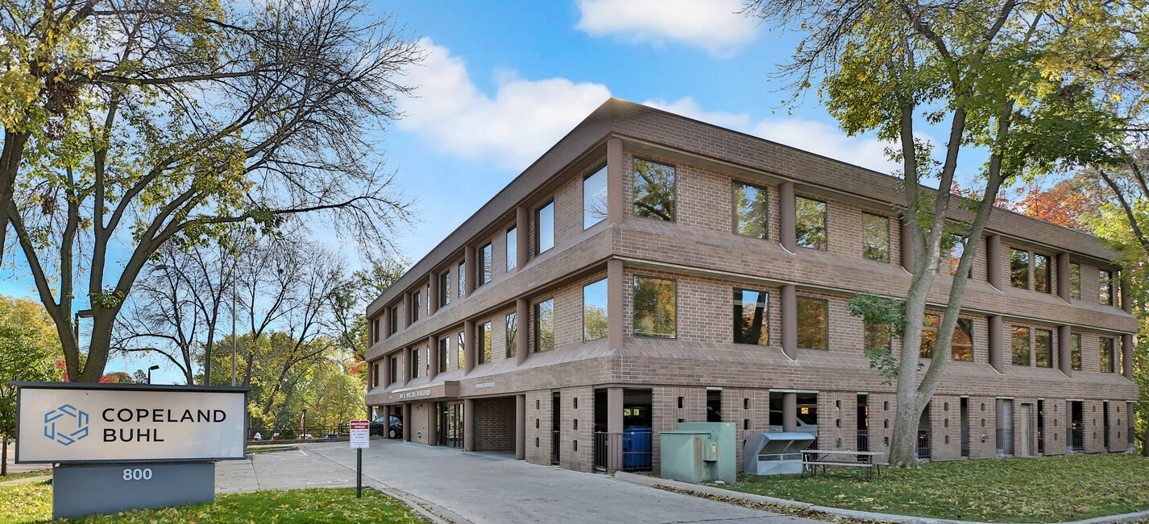
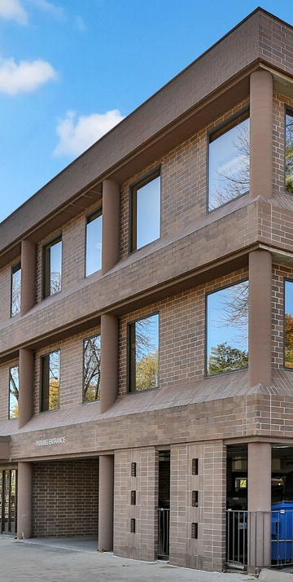
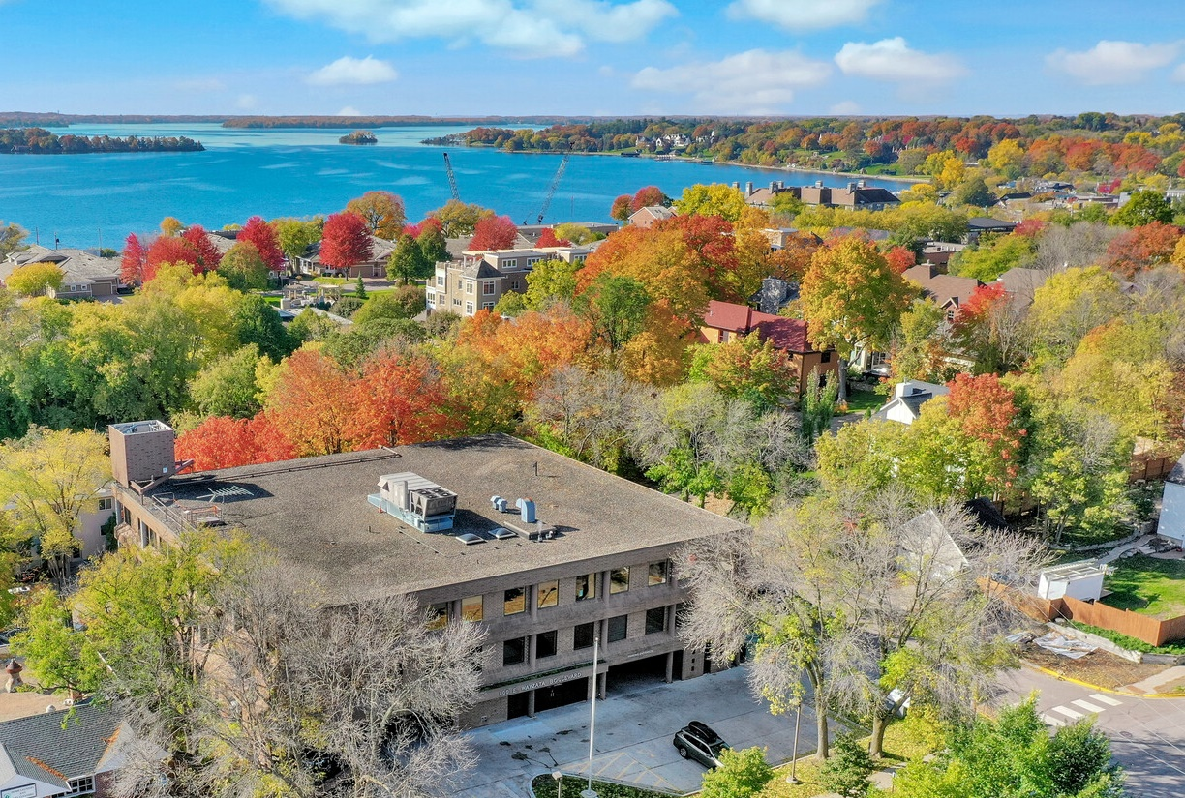
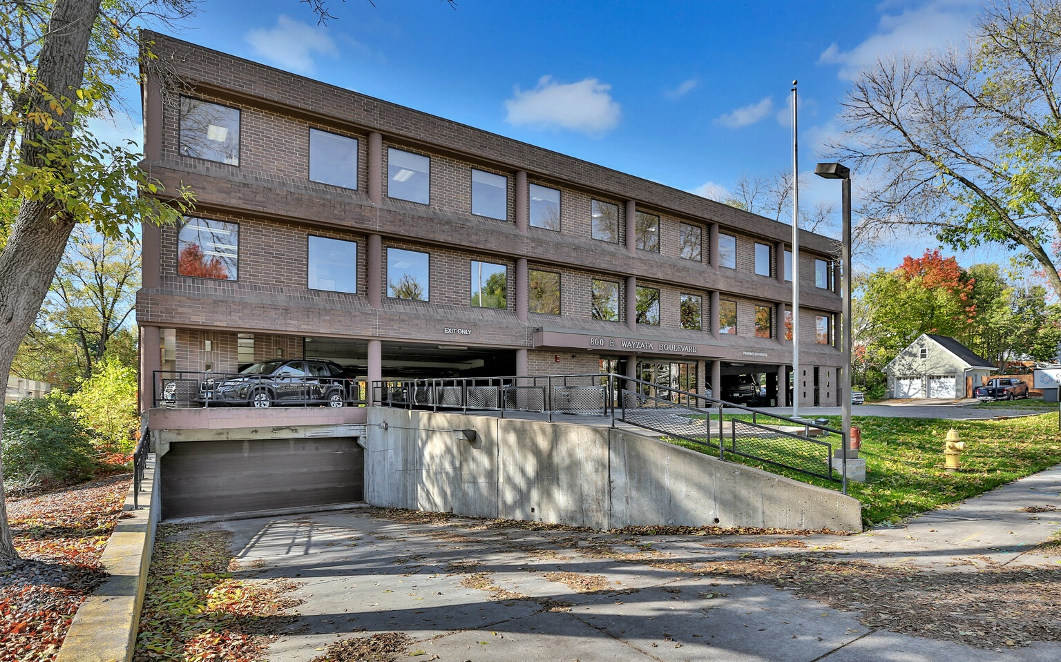
800 WAYZATA BLVD
ws.partners
Notes:
MC

Slide 16
Results to Date
- Collected rent & maintained property
- Obtained renderings and priced renovation
- Engaged JLL to market for lease or sale
2024 & Beyond
- Find buyer or tenant to kick-off renovation
800 WAYZATA BLVD
ws.partners
Notes:
MC

Slide 17
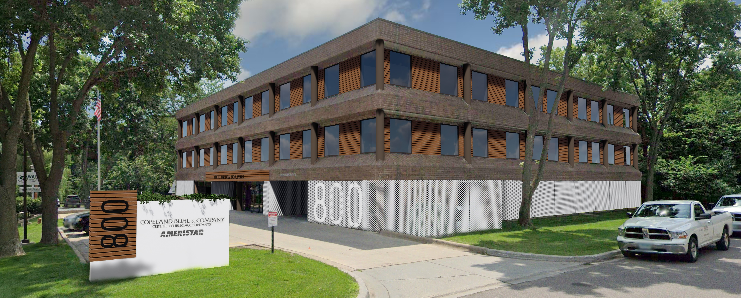
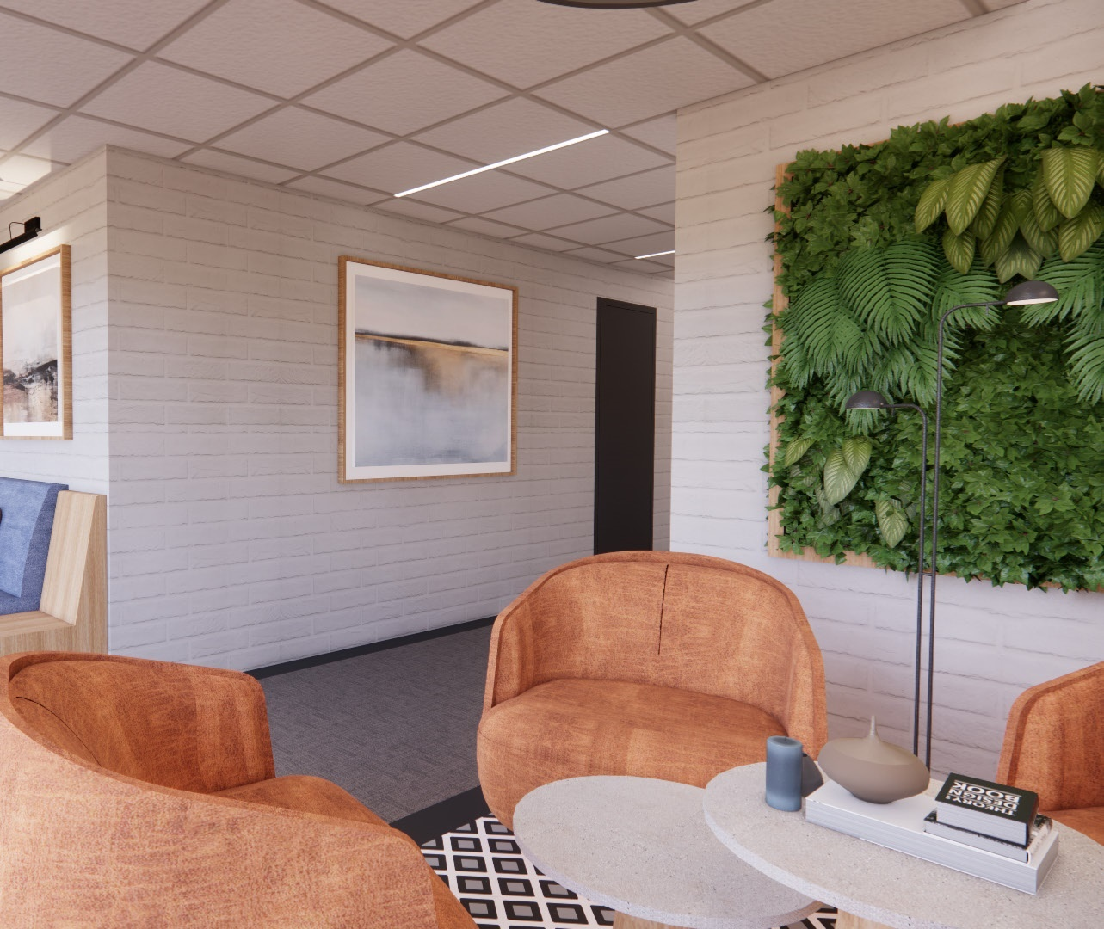
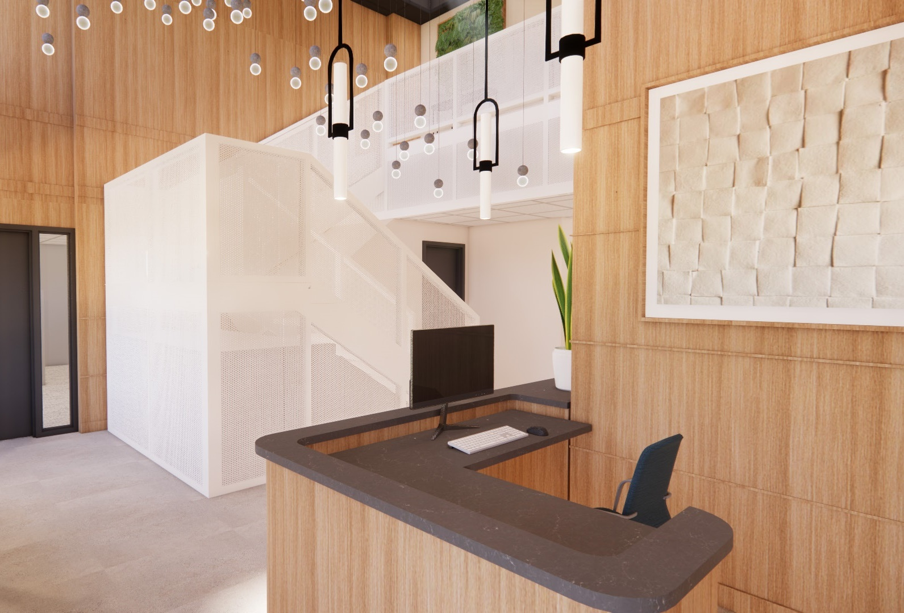
Project Renderings
800 WAYZATA BLVD
ws.partners
Notes:
MC

Slide 18

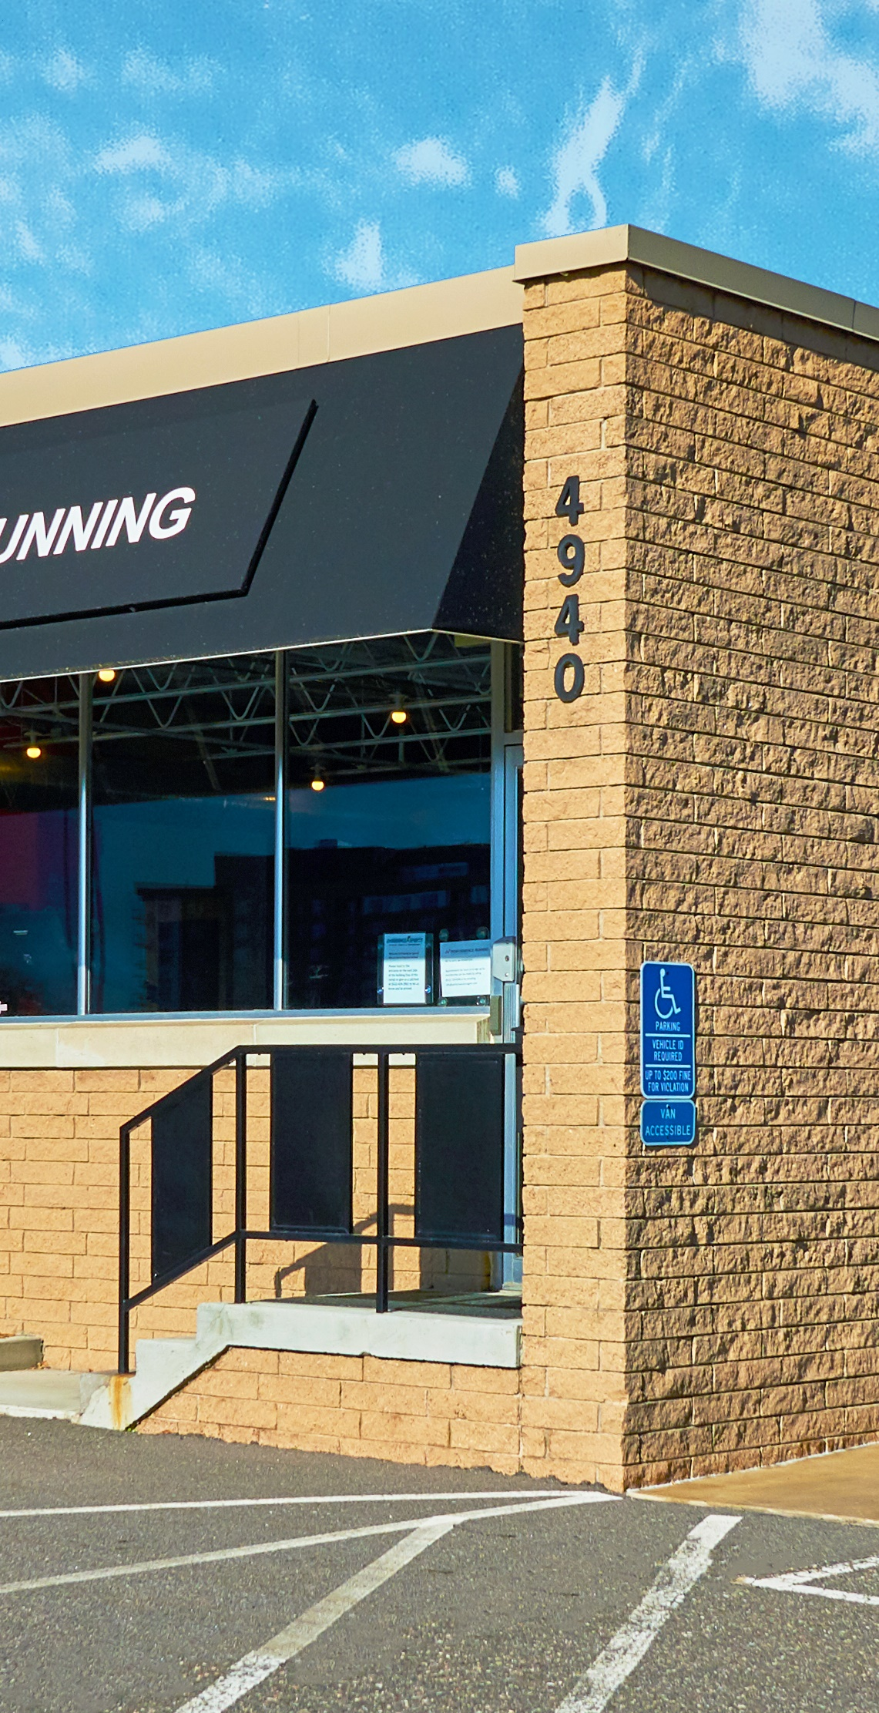
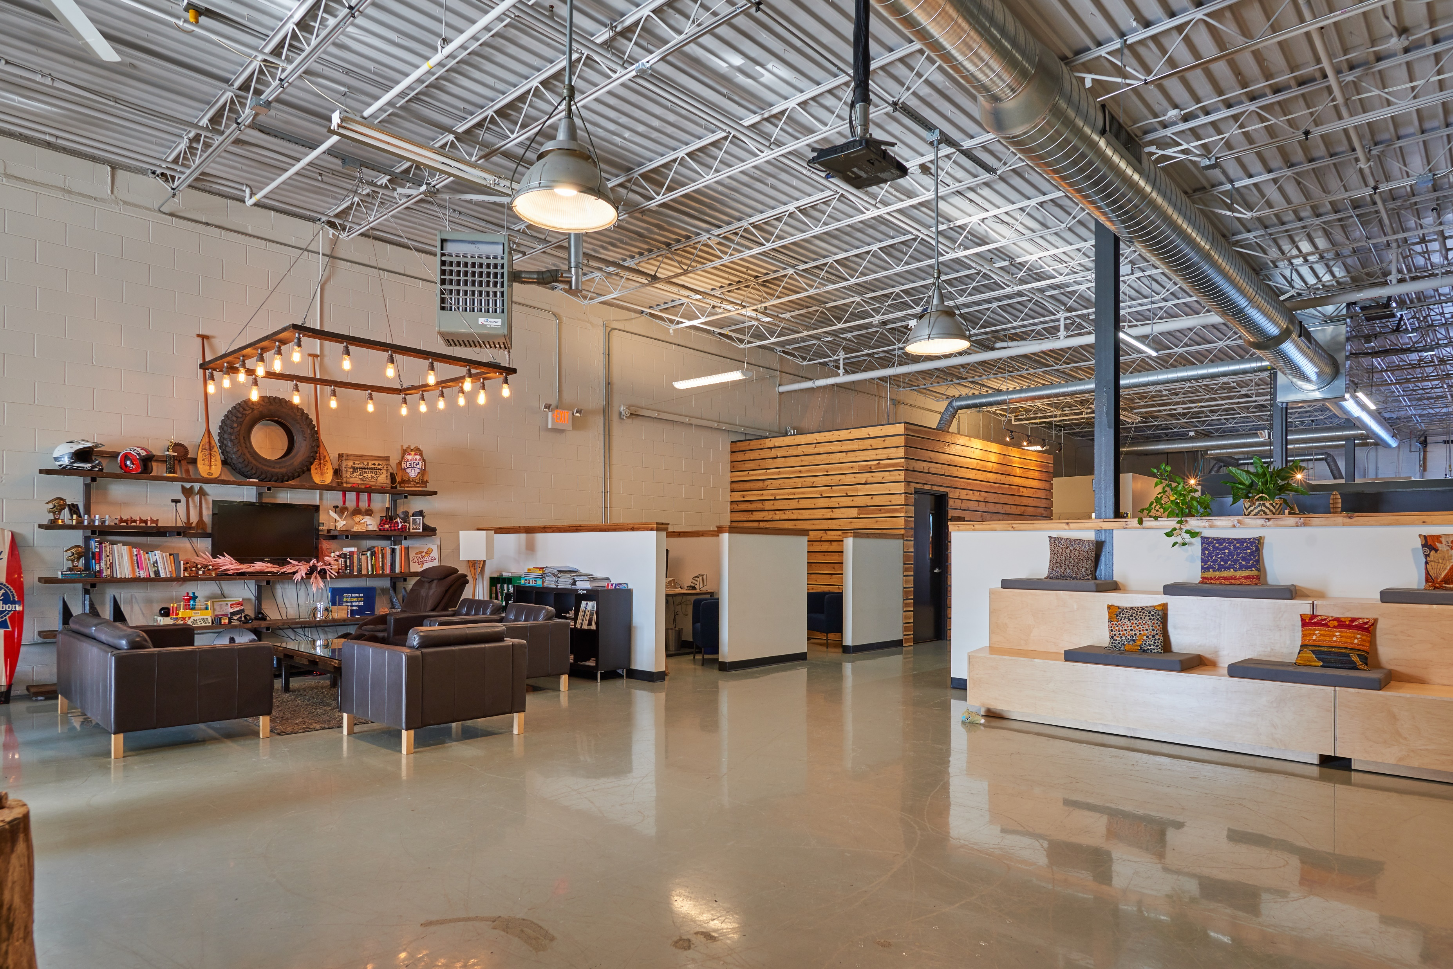
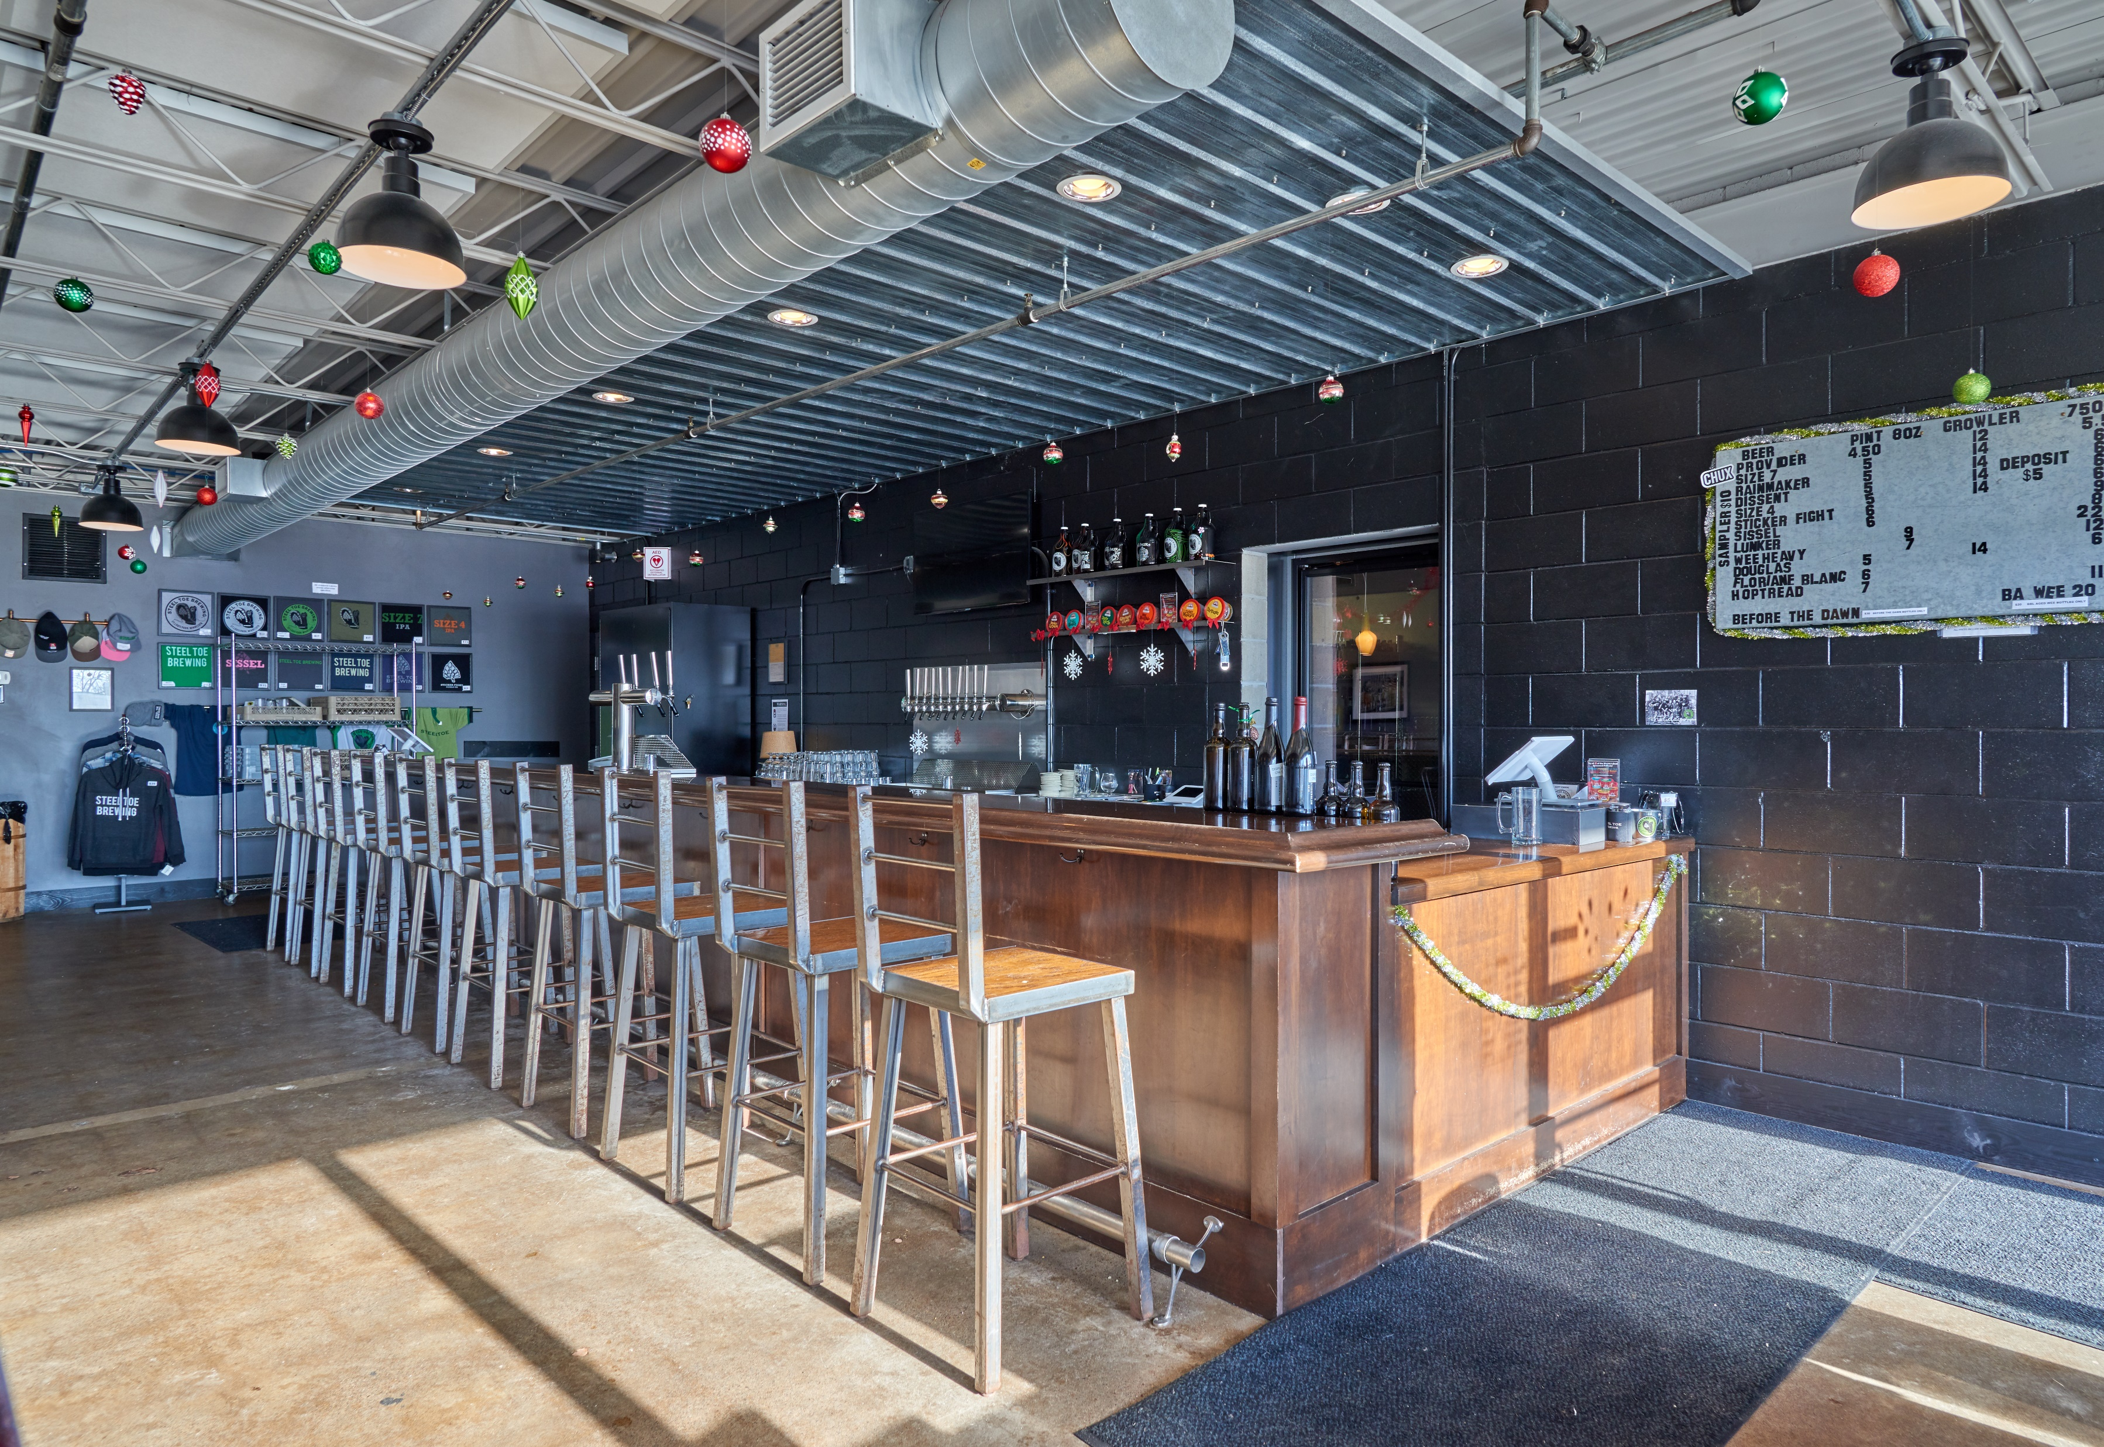
BELTLINE PORTFOLIO
ws.partners
Notes:
MC

Slide 19
Results to Date
- Re-leased to 100% (+14.7%)
- Increased rents by $1.45 (18.4%)
- Completed sprinkler install & parking lot
- Successfully appealed taxes
2024 & Beyond
- Complete restructuring of REM5 lease
- Renew SixSpeed 1-2 years
BELTLINE PORTFOLIO
ws.partners
Notes:
MC

Slide 20
How are we looking?
Year of Sale:
Exit Cap:
Profit¹:
IRR¹:
EM¹:
610
2025
7.75%
$2.8M
10.73%
1.74x
Union
2026
9.00%
$3.3M
9.37%
1.79x
Wayzata
2024
n/a
$1.0M
14.47%
1.75x
Beltline
2024
7.00%
$1.8M
13.53%
1.63x
FUND I
ws.partners
¹ Profit, IRR & EM are deal-level projections, net of fees
Notes:
JH

Slide 21
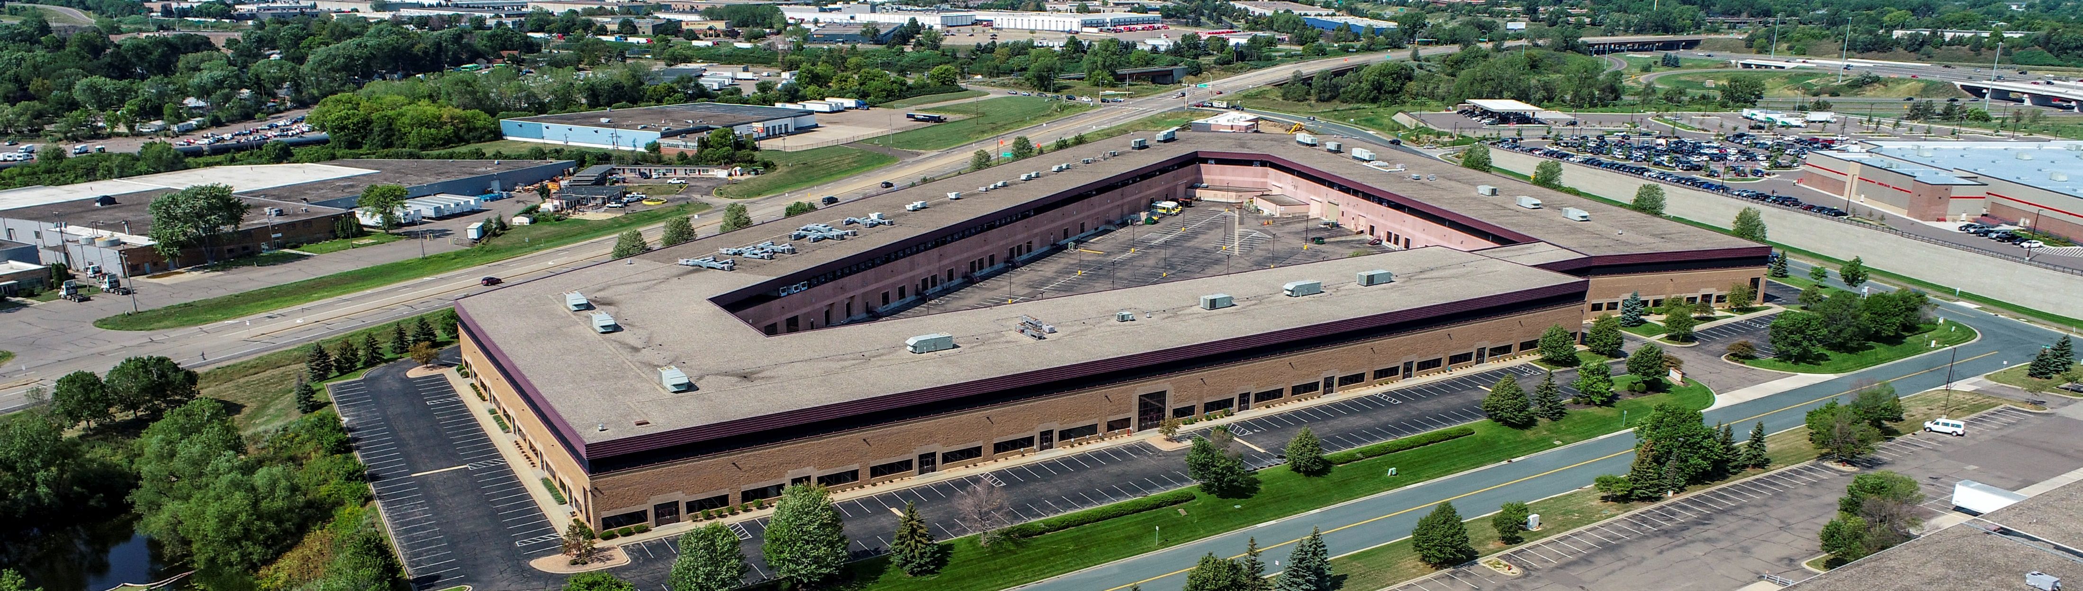
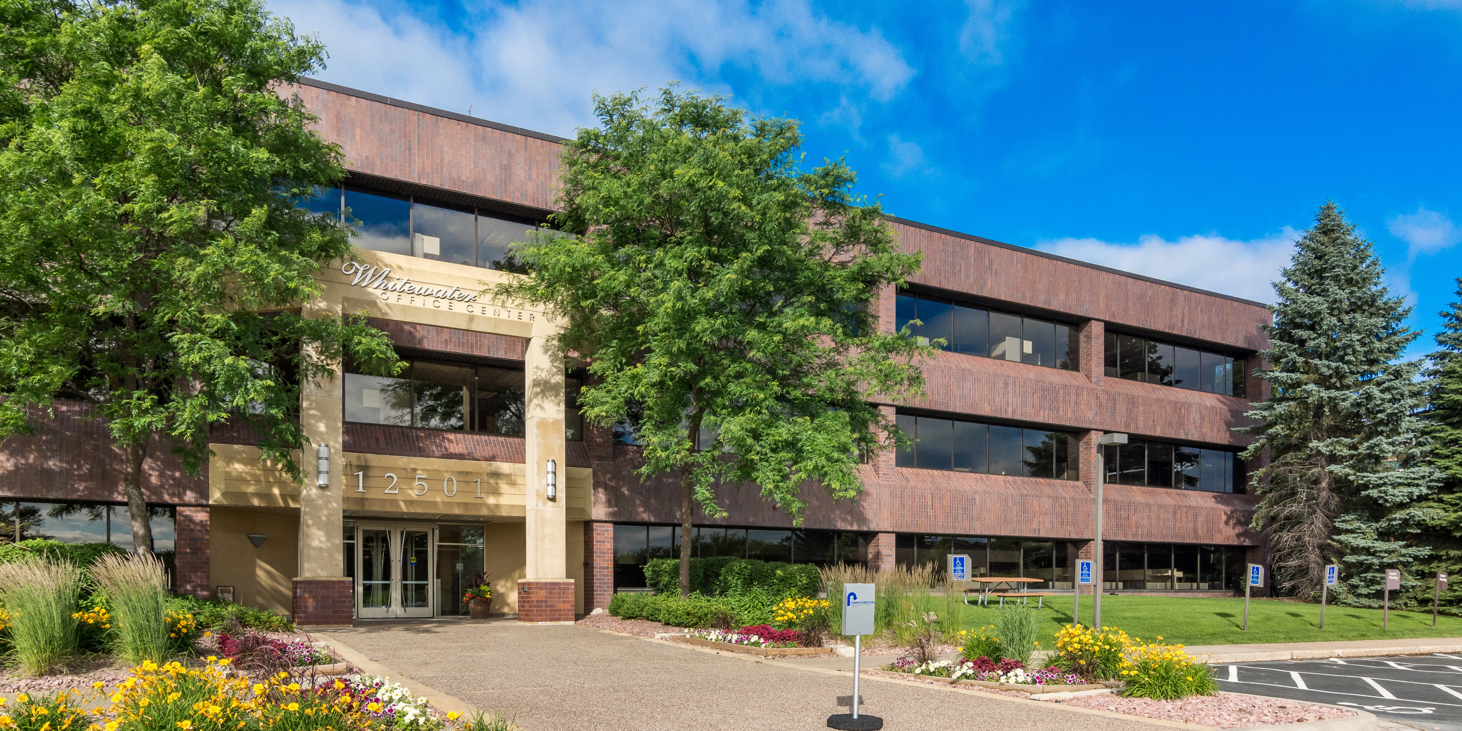
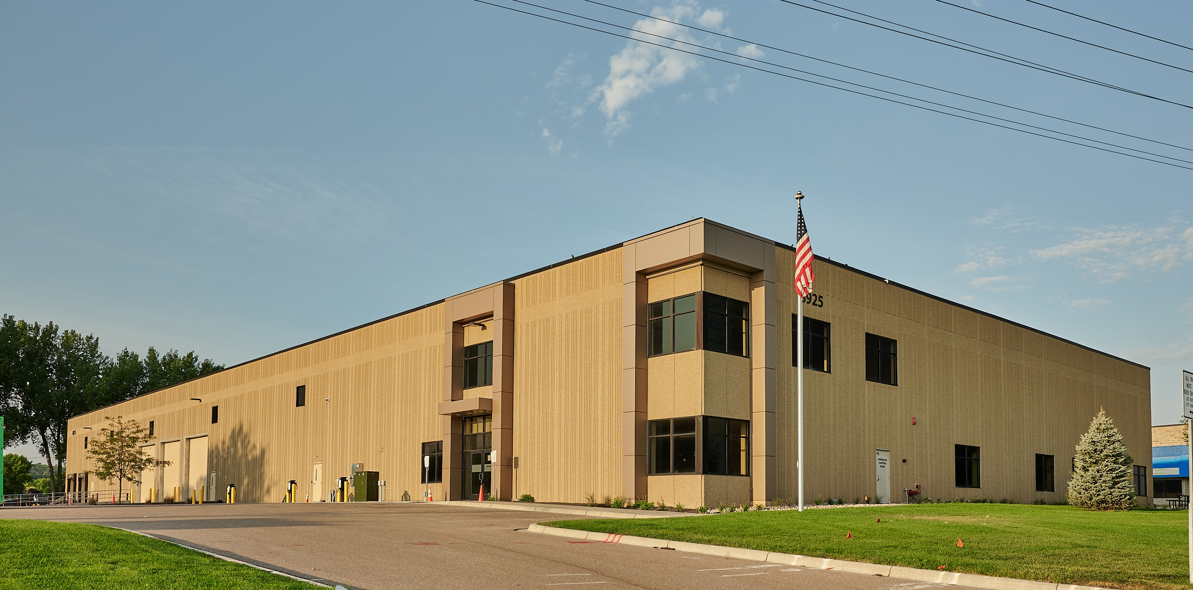
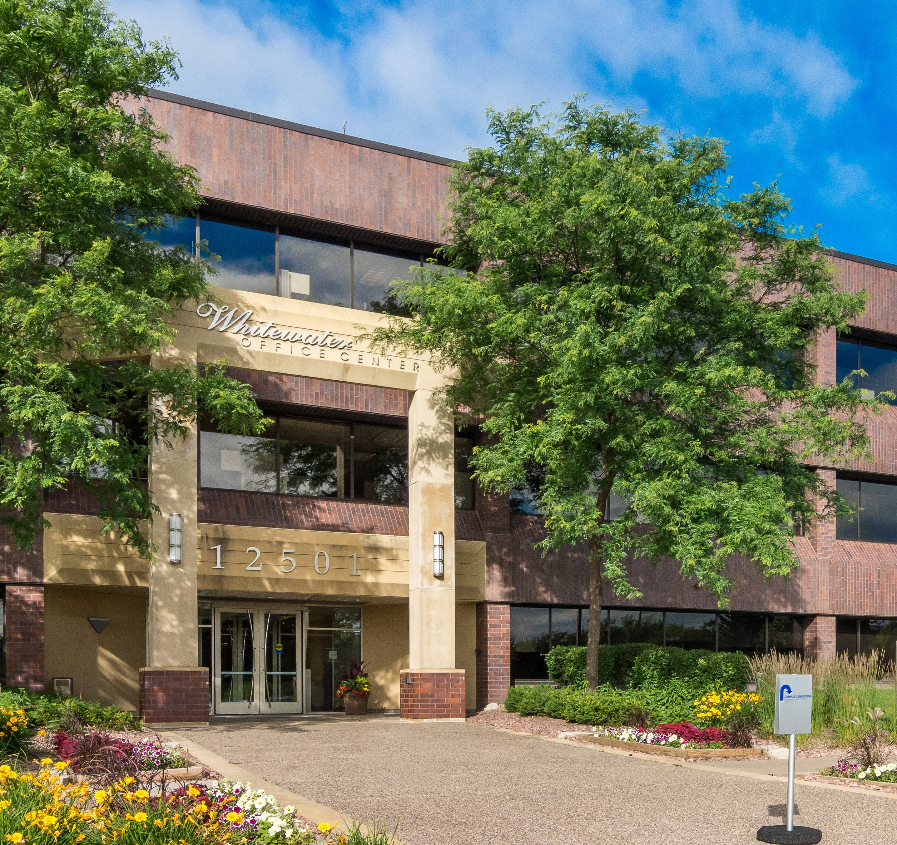
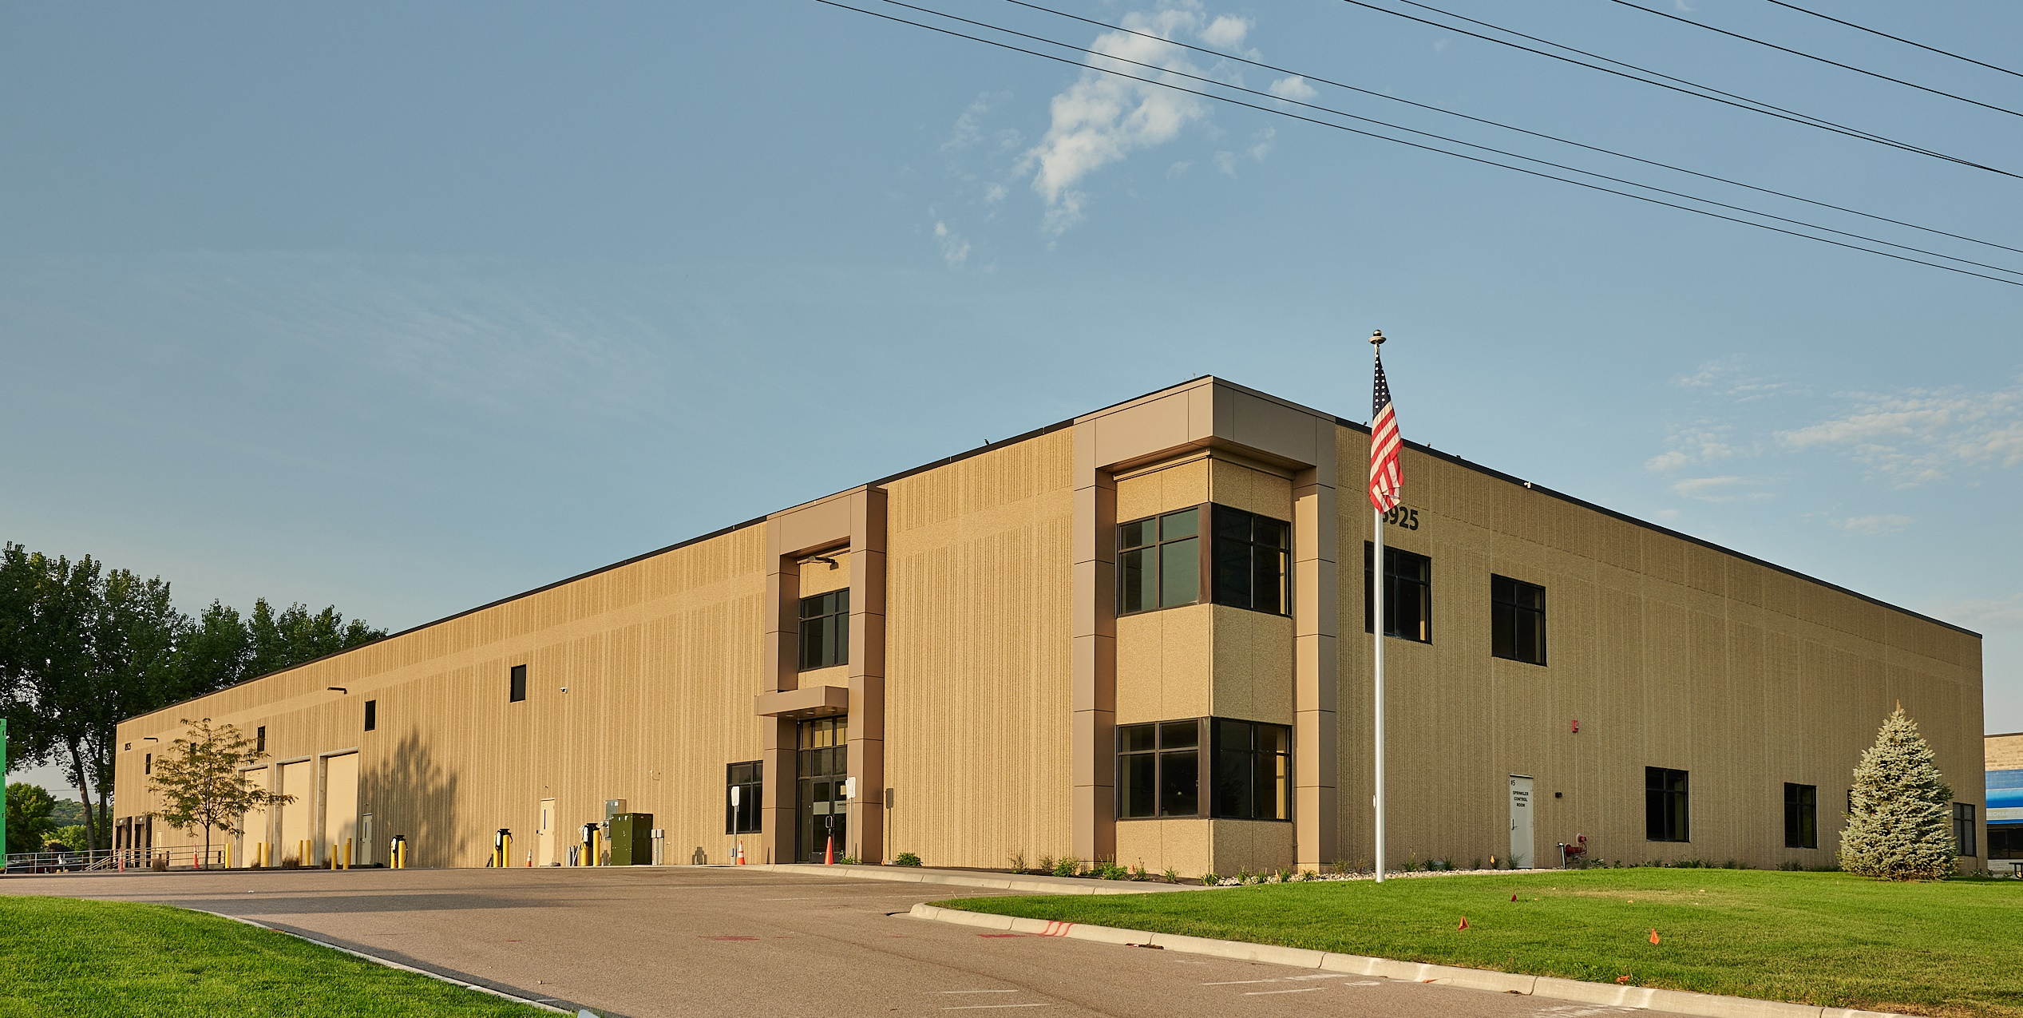
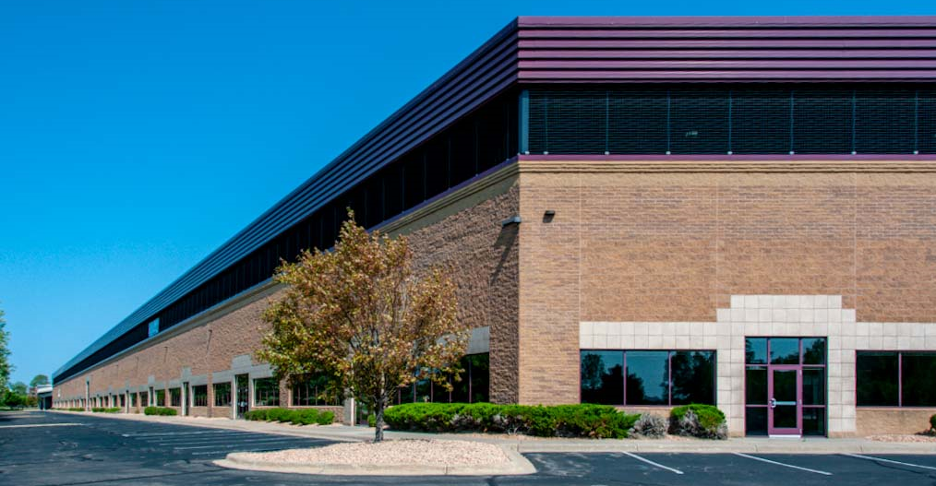
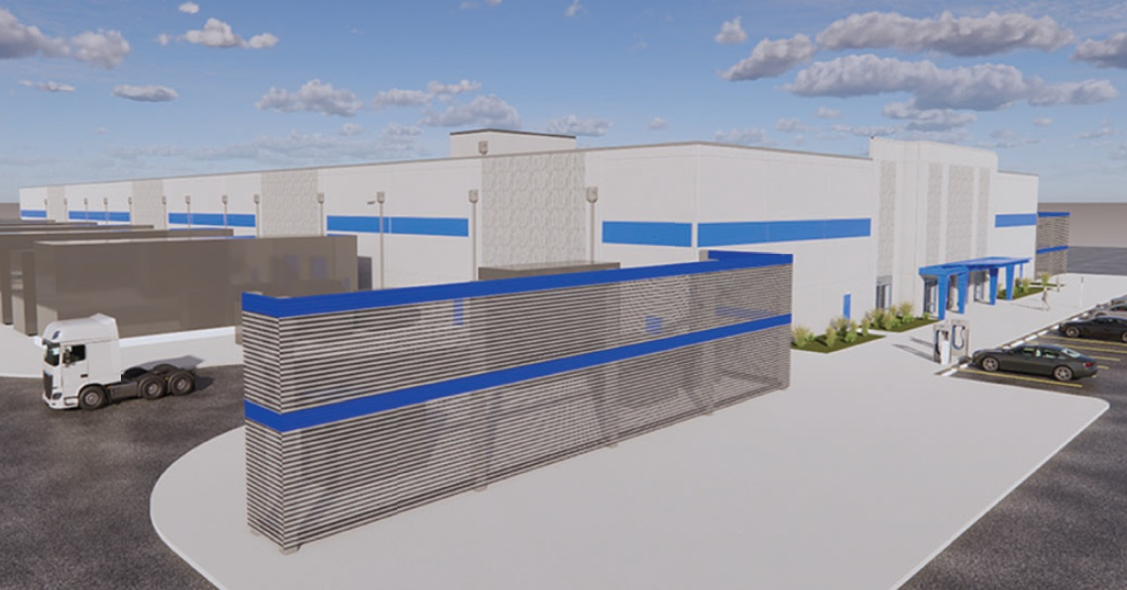
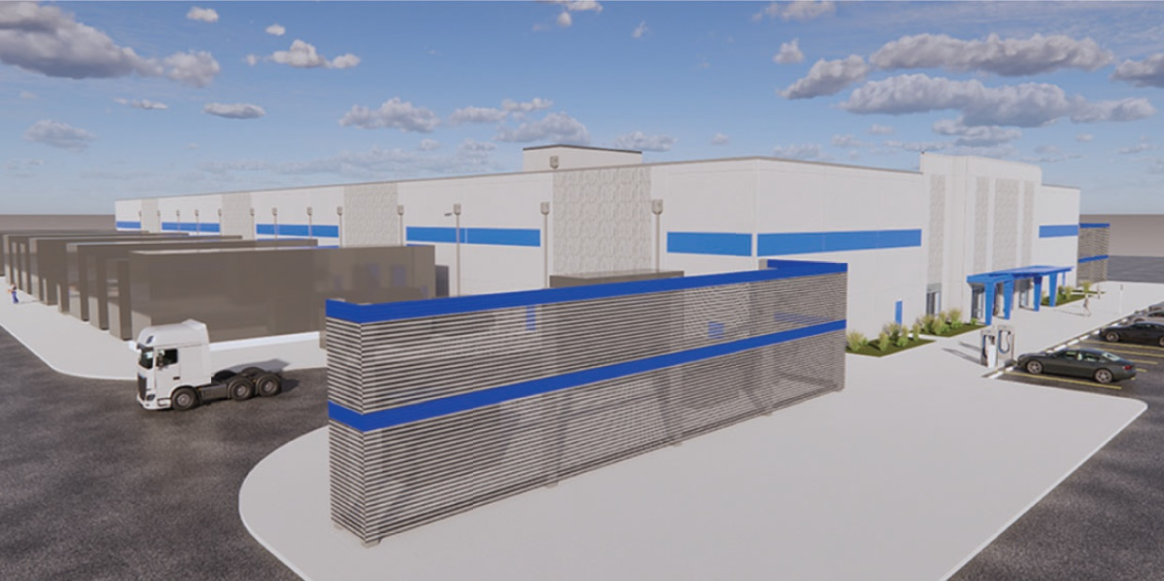
WATER STREET FUND II
ws.partners
Notes:
JH

Slide 22
The big picture...
Initial Closing:
Final Investment:
Capital Calls:
Distributions:
Avg. Cash Flow:
Leverage:
Leased:
Targeted IRR (Net):
July 2021
March 2023
$22.40MM
$0.00MM
N/A
65.5%
80.5%
15%+
FUND II
ws.partners
Notes:
JH

Slide 23
Growing NOI on lease-up assets
Current
NOI %
9.49%
7.60%
5.63%
7.47%
Initial
NOI %
6.44%
7.60%
5.15%
7.47%
Change
+3.05%
+0.00%
+0.48%
+0.00%
WW
Savage
Eagan¹
DCP
FUND II
ws.partners
¹ Current projected stabilized yield for Eagan is 10.32%
Notes:
JH

Slide 24
Debt Maturities
Rate
4.44%
5.85%
5.65%
7.63%
5.77%
LTC
62.9%
65.0%
64.7%
70.0%
65.5%
Maturity
Dec-31
Nov-25
Nov-27
2026-8
WW¹
Savage
Eagan
DCP²
Average
FUND II
ws.partners
¹ Whitewater loan will be 100% fixed in Apr. 2024; rate resets in 2026
² Data center project rates are variable at SOFR + 200-250 bps
Notes:
JH

Slide 25
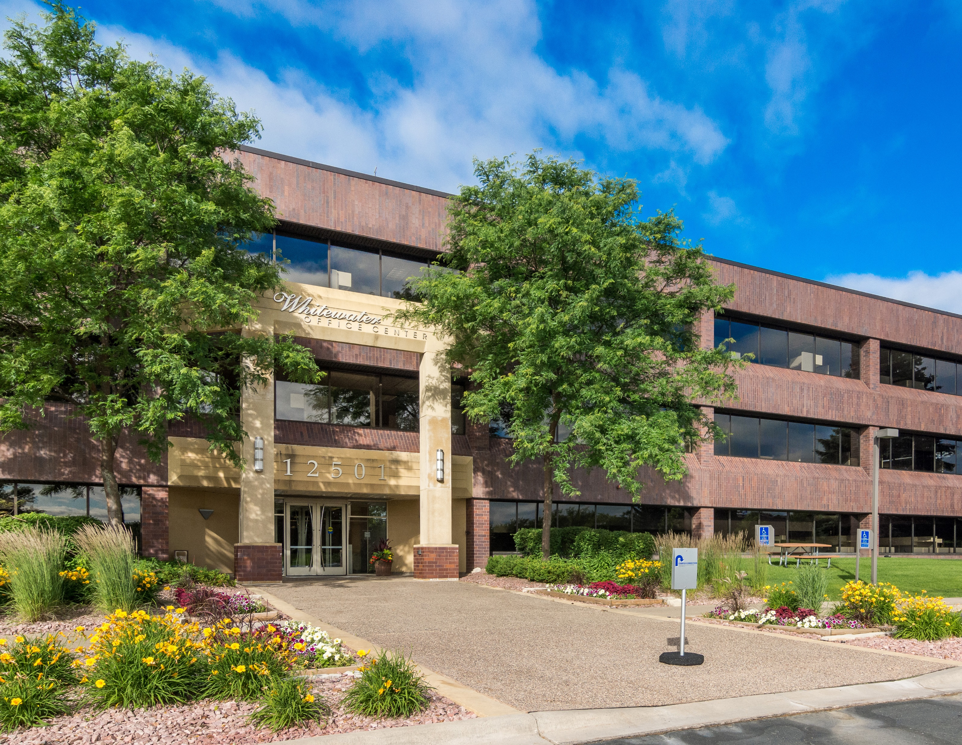
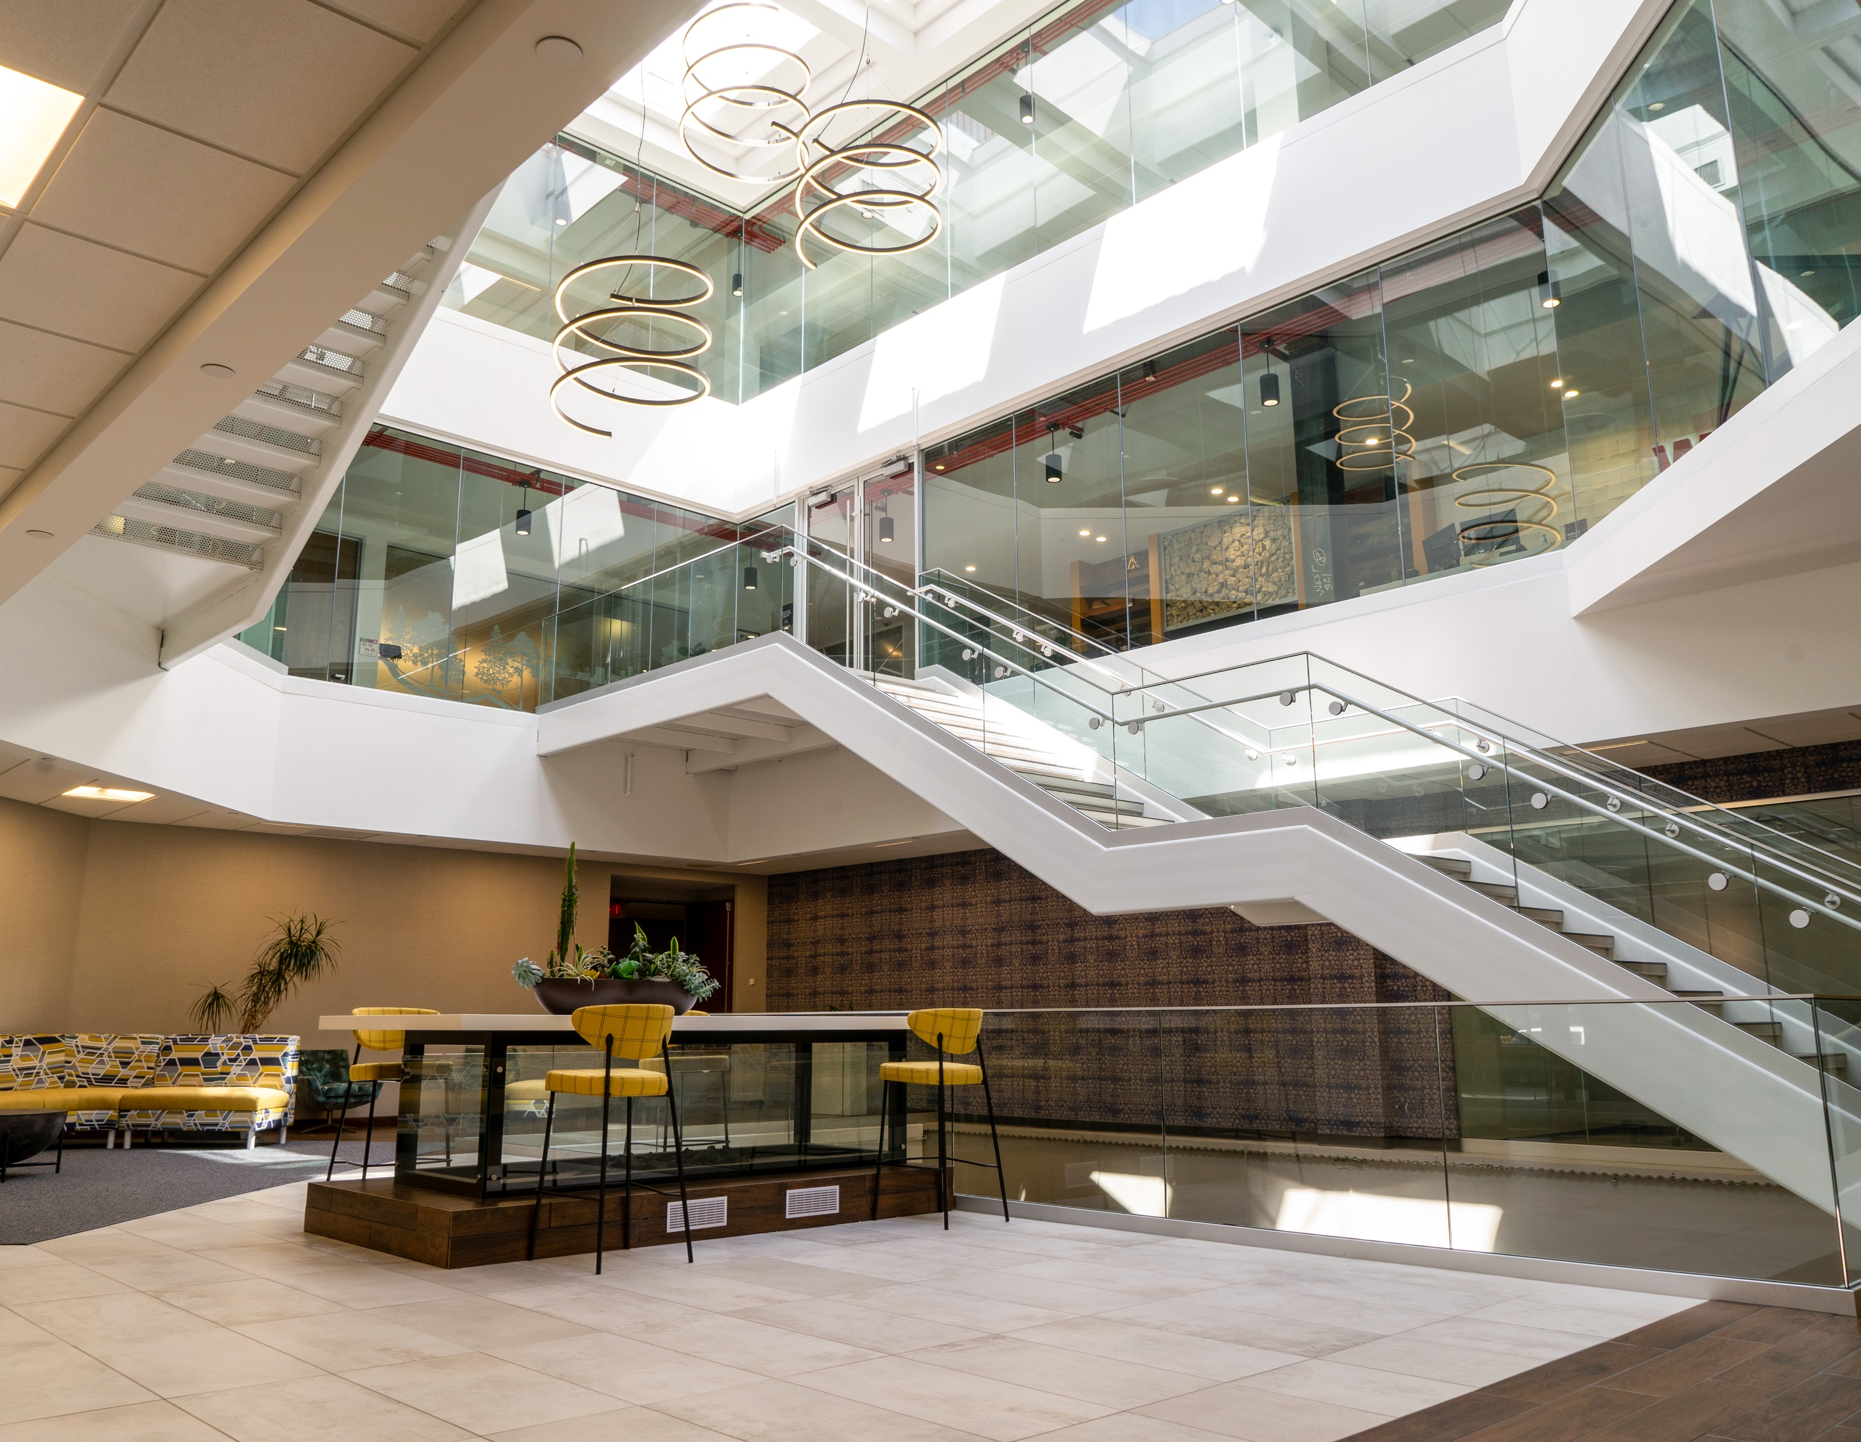
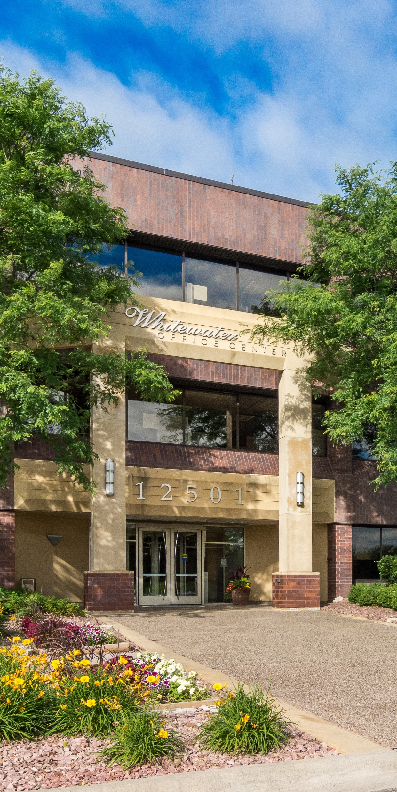
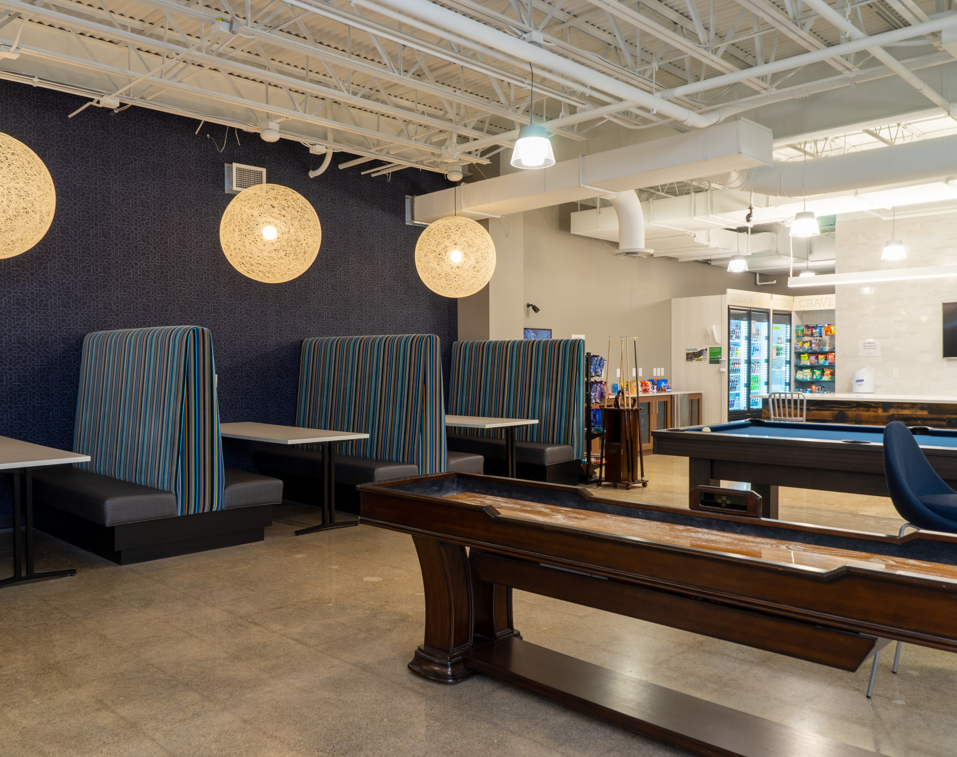
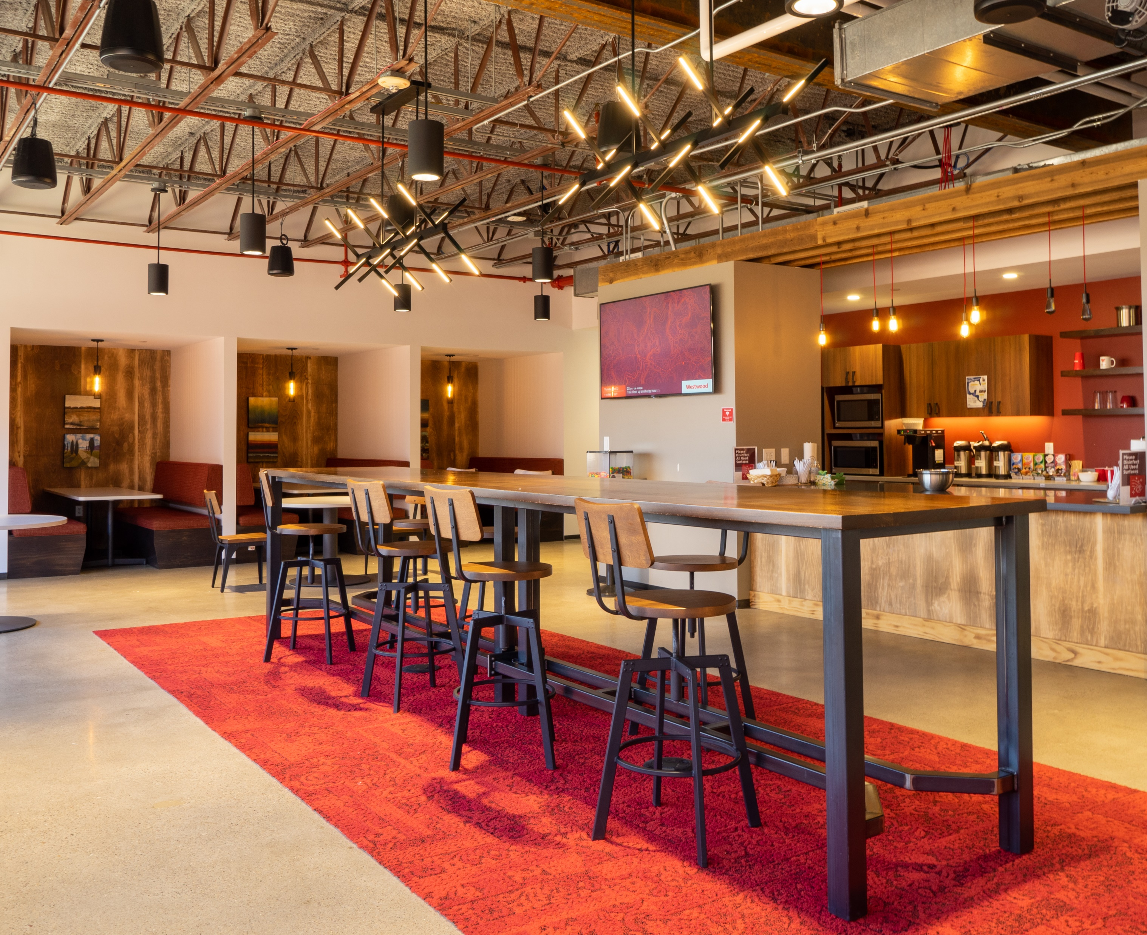
WHITEWATER RESERVE
ws.partners
Notes:
MC

Slide 26
Results to Date
- Raised occupancy by 30.2% (to 98.4%)
- Increased rents by $2.22 (16.5%) to $15.69
- Completed Link renovation project
2024 & Beyond
- Renew Westwood and BBQ Holdings
- Amend signage plan with city of Minnetonka
- Closely monitor capital markets for office
WHITEWATER RESERVE
ws.partners
Notes:
MC

Slide 27
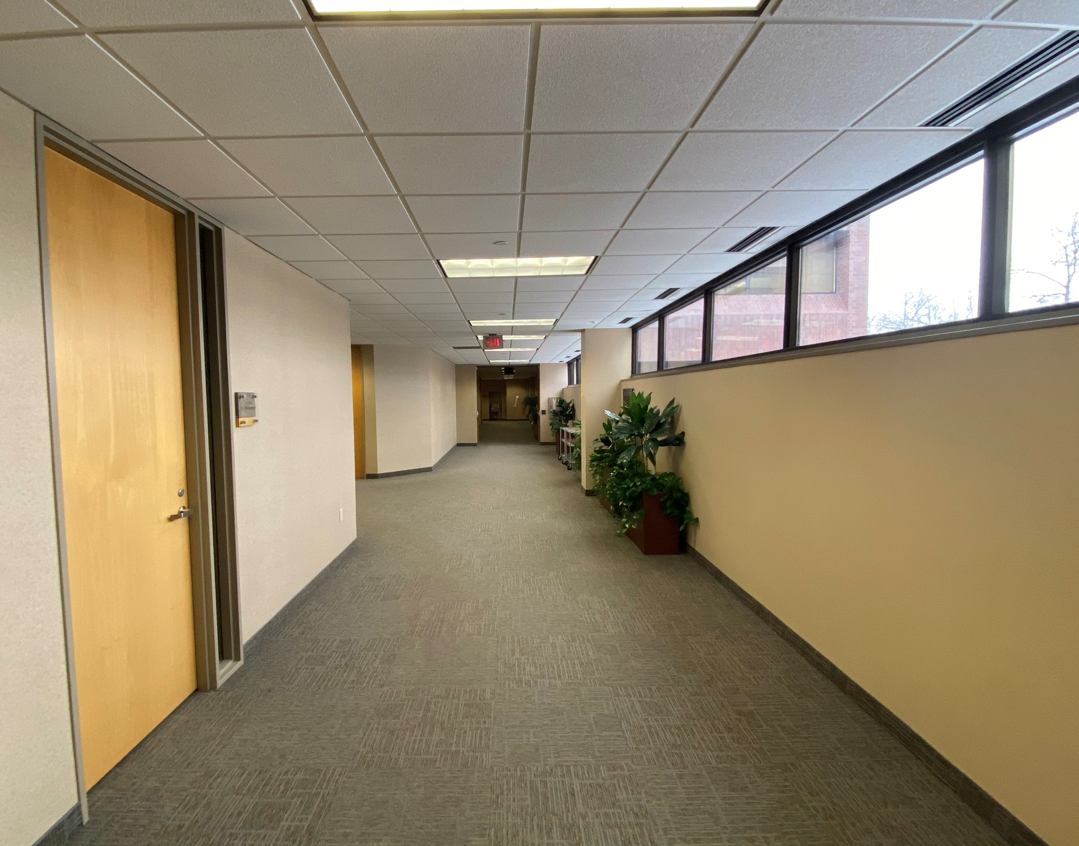
WHITEWATER RESERVE
ws.partners
The Link - Before
Notes:
MC

Slide 28



Add before/after photos of link?
WHITEWATER RESERVE
ws.partners
After
Notes:
MC

Slide 29




SAVAGE R&D FACILITY
ws.partners
Notes:
MC

Slide 30
Results to Date
- Completed build-out and commenced lease
- Agreed to terms with buyer for Q1 2024 sale
2024 & Beyond
- Close transaction at the agreed upon terms
SAVAGE R&D FACILITY
ws.partners
Notes:
MC

Slide 31




EAGAN INNOVATION CENTER
ws.partners
Notes:
JR

Slide 32
Results to Date
- Issued 7 lease proposals totaling 464k sf
- Extended Amazon parking lease
- Delivered CAE expansion space
- Parking lot, vacancy prep & signage
2024 & Beyond
- LEASES! Execute 130,000 sf of new leases
- Look for other sources of parking revenue
EAGAN INNOVATION CENTER
ws.partners
Notes:
JR

Slide 33




DATA CENTER PORTFOLIO
ws.partners
Notes:
RD

Slide 34
Why data center developments?
- Compelling risk-adjusted return
- Direct access to institutional grade projects
- Diversification across markets
How do we fit in?
- GP investment alongside Oppidan
- Investor shares in promote
- No guaranties/recourse to investors
DATA CENTER PORTFOLIO
ws.partners
Notes:
RD

Slide 35
Results to Date
- Closed on all investments in 2023
- Projects tracking to schedule & budget
2024 & Beyond
- Ensure completion of all projects
- Negotiate terms of put/exit with Cloud
DATA CENTER PORTFOLIO
ws.partners
Notes:
RD

Slide 36
How are we looking?
Year of Sale:
Exit Cap:
Profit¹:
IRR¹:
EM¹:
WW
2026
8.50%
$8.3M
15.90%
1.92x
Savage
2024
6.29%
$0.9M
23.62%
1.33x
Eagan
2026
8.50%
$15.0M
20.10%
2.03x
DCP
2024-5
6.50%
$4.2M
36.01%
1.84x
FUND II
ws.partners
¹ Profit, IRR & EM are deal-level projections, net of fees
Notes:
JB

Slide 37
What’s Next?
Strategy:
Target Returns:
Target Equity:
Target Leverage:
Target Holds:
Value-Add
20%+
$30.00MM
60%
3 – 5 years
ws.partners
Notes:
JB – cover where we see opportunity, geography, property type

Slide 38
Thank you for joining us!
Any questions?
ws.partners
Notes:
JH

